Slide 1
281st Memorial Service

Slide 2


Slide 3

In the early 1960’s the war in Vietnam began to escalate and was to become known as the “helicopter war”. A group of young men anxious to serve their country and be a part of army aviation answered the call to arms. From 1965 to 1970 a small group of these men, unknown to each other, was brought together to create the US Army’s First Special Operations Helicopter Company. Assigned to 5th Special Forces Group elite and highly classified intelligence gathering unit, “Project Delta”, they developed and perfected techniques specifically for Special Operations missions that would be passed on to future generations of aviators.
The demand for perfection and completion of the mission bound the members of this unit into a solid band of brothers capable of performing impossible tasks.
The men of the 281st Assault Helicopter Company earned the reputation with the Delta men they were supporting “they would get us out or die trying”. It was this devotion to duty that ultimately cost the lives of 53 of our brothers.
Although individuals would serve together for just one year on average, the friendships and memories would last forever. This slide show is dedicated to those memories and our 53 fallen brothers.

Slide 4
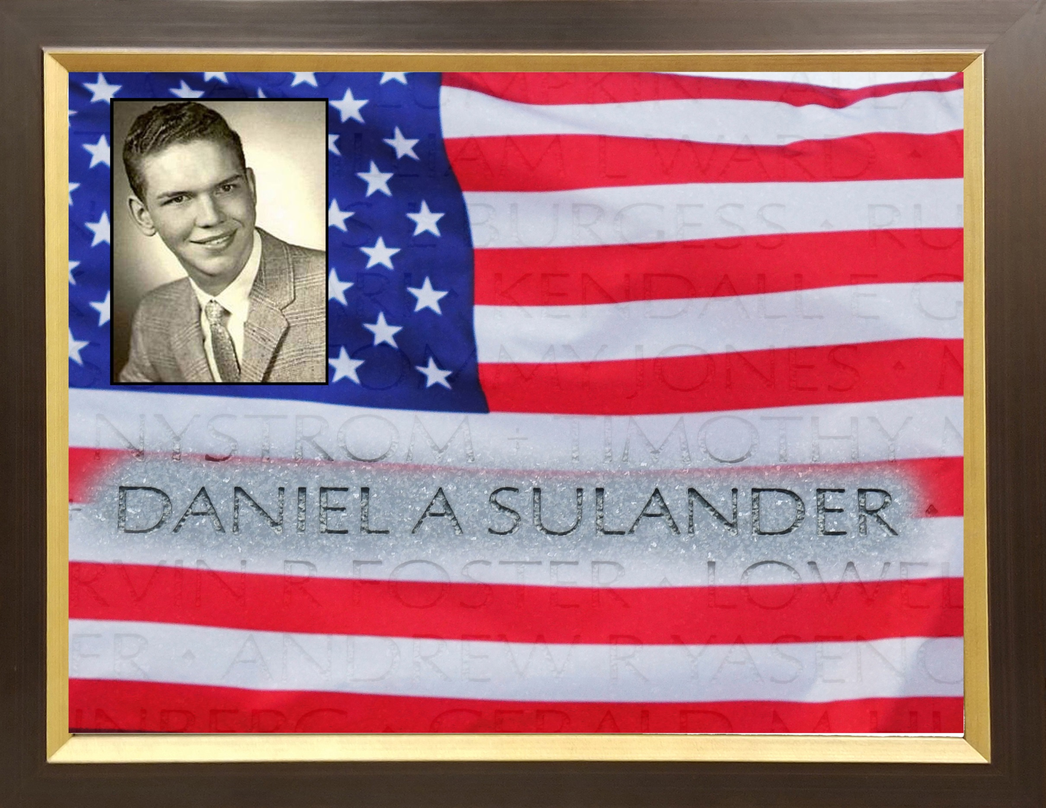

Slide 5
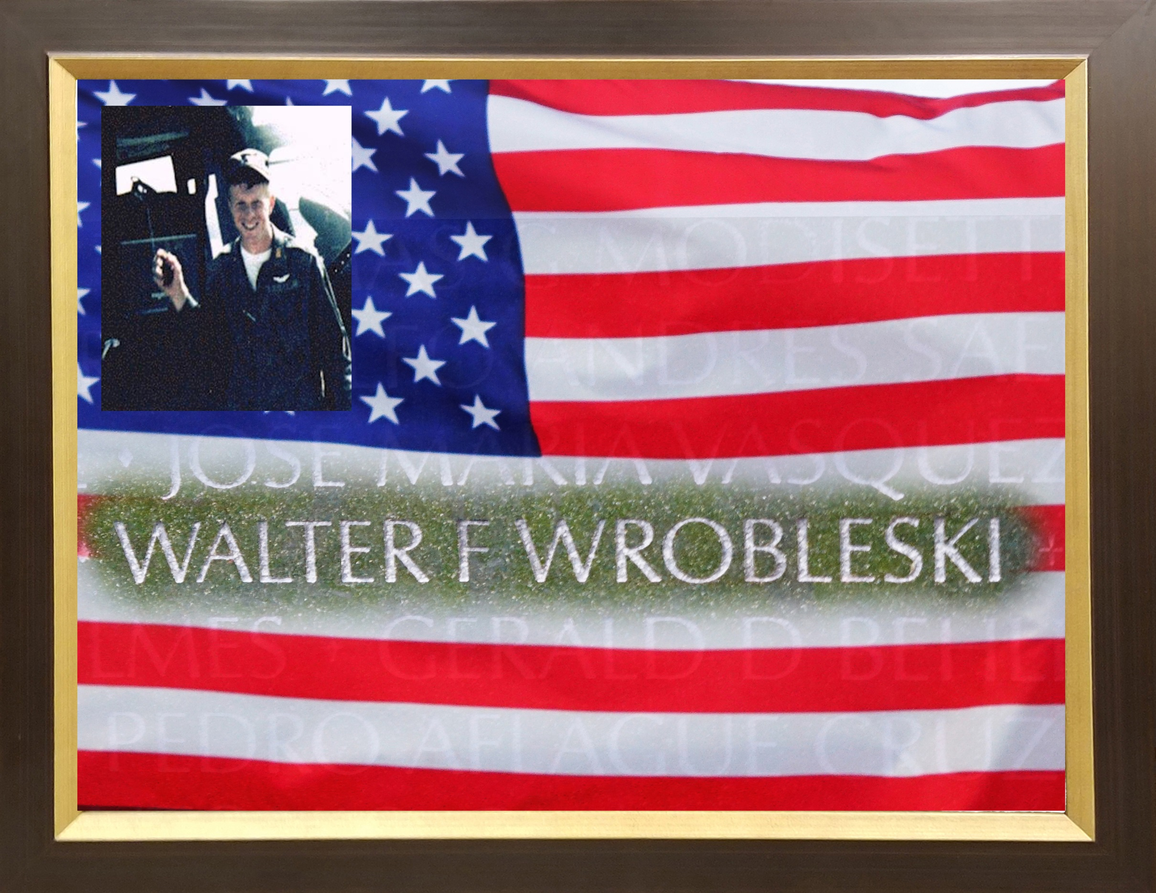

Slide 6
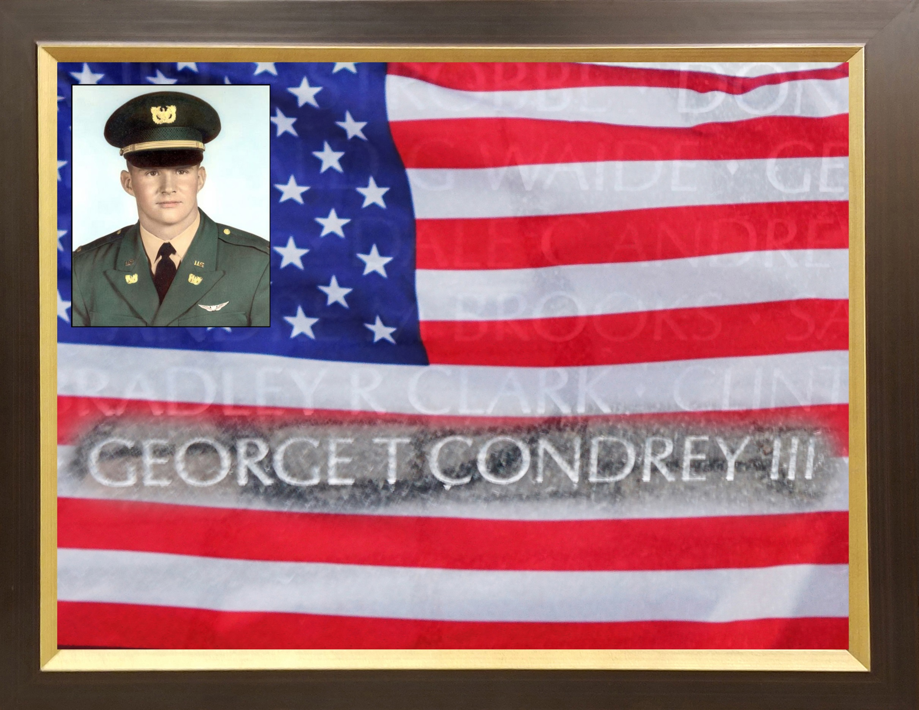

Slide 7
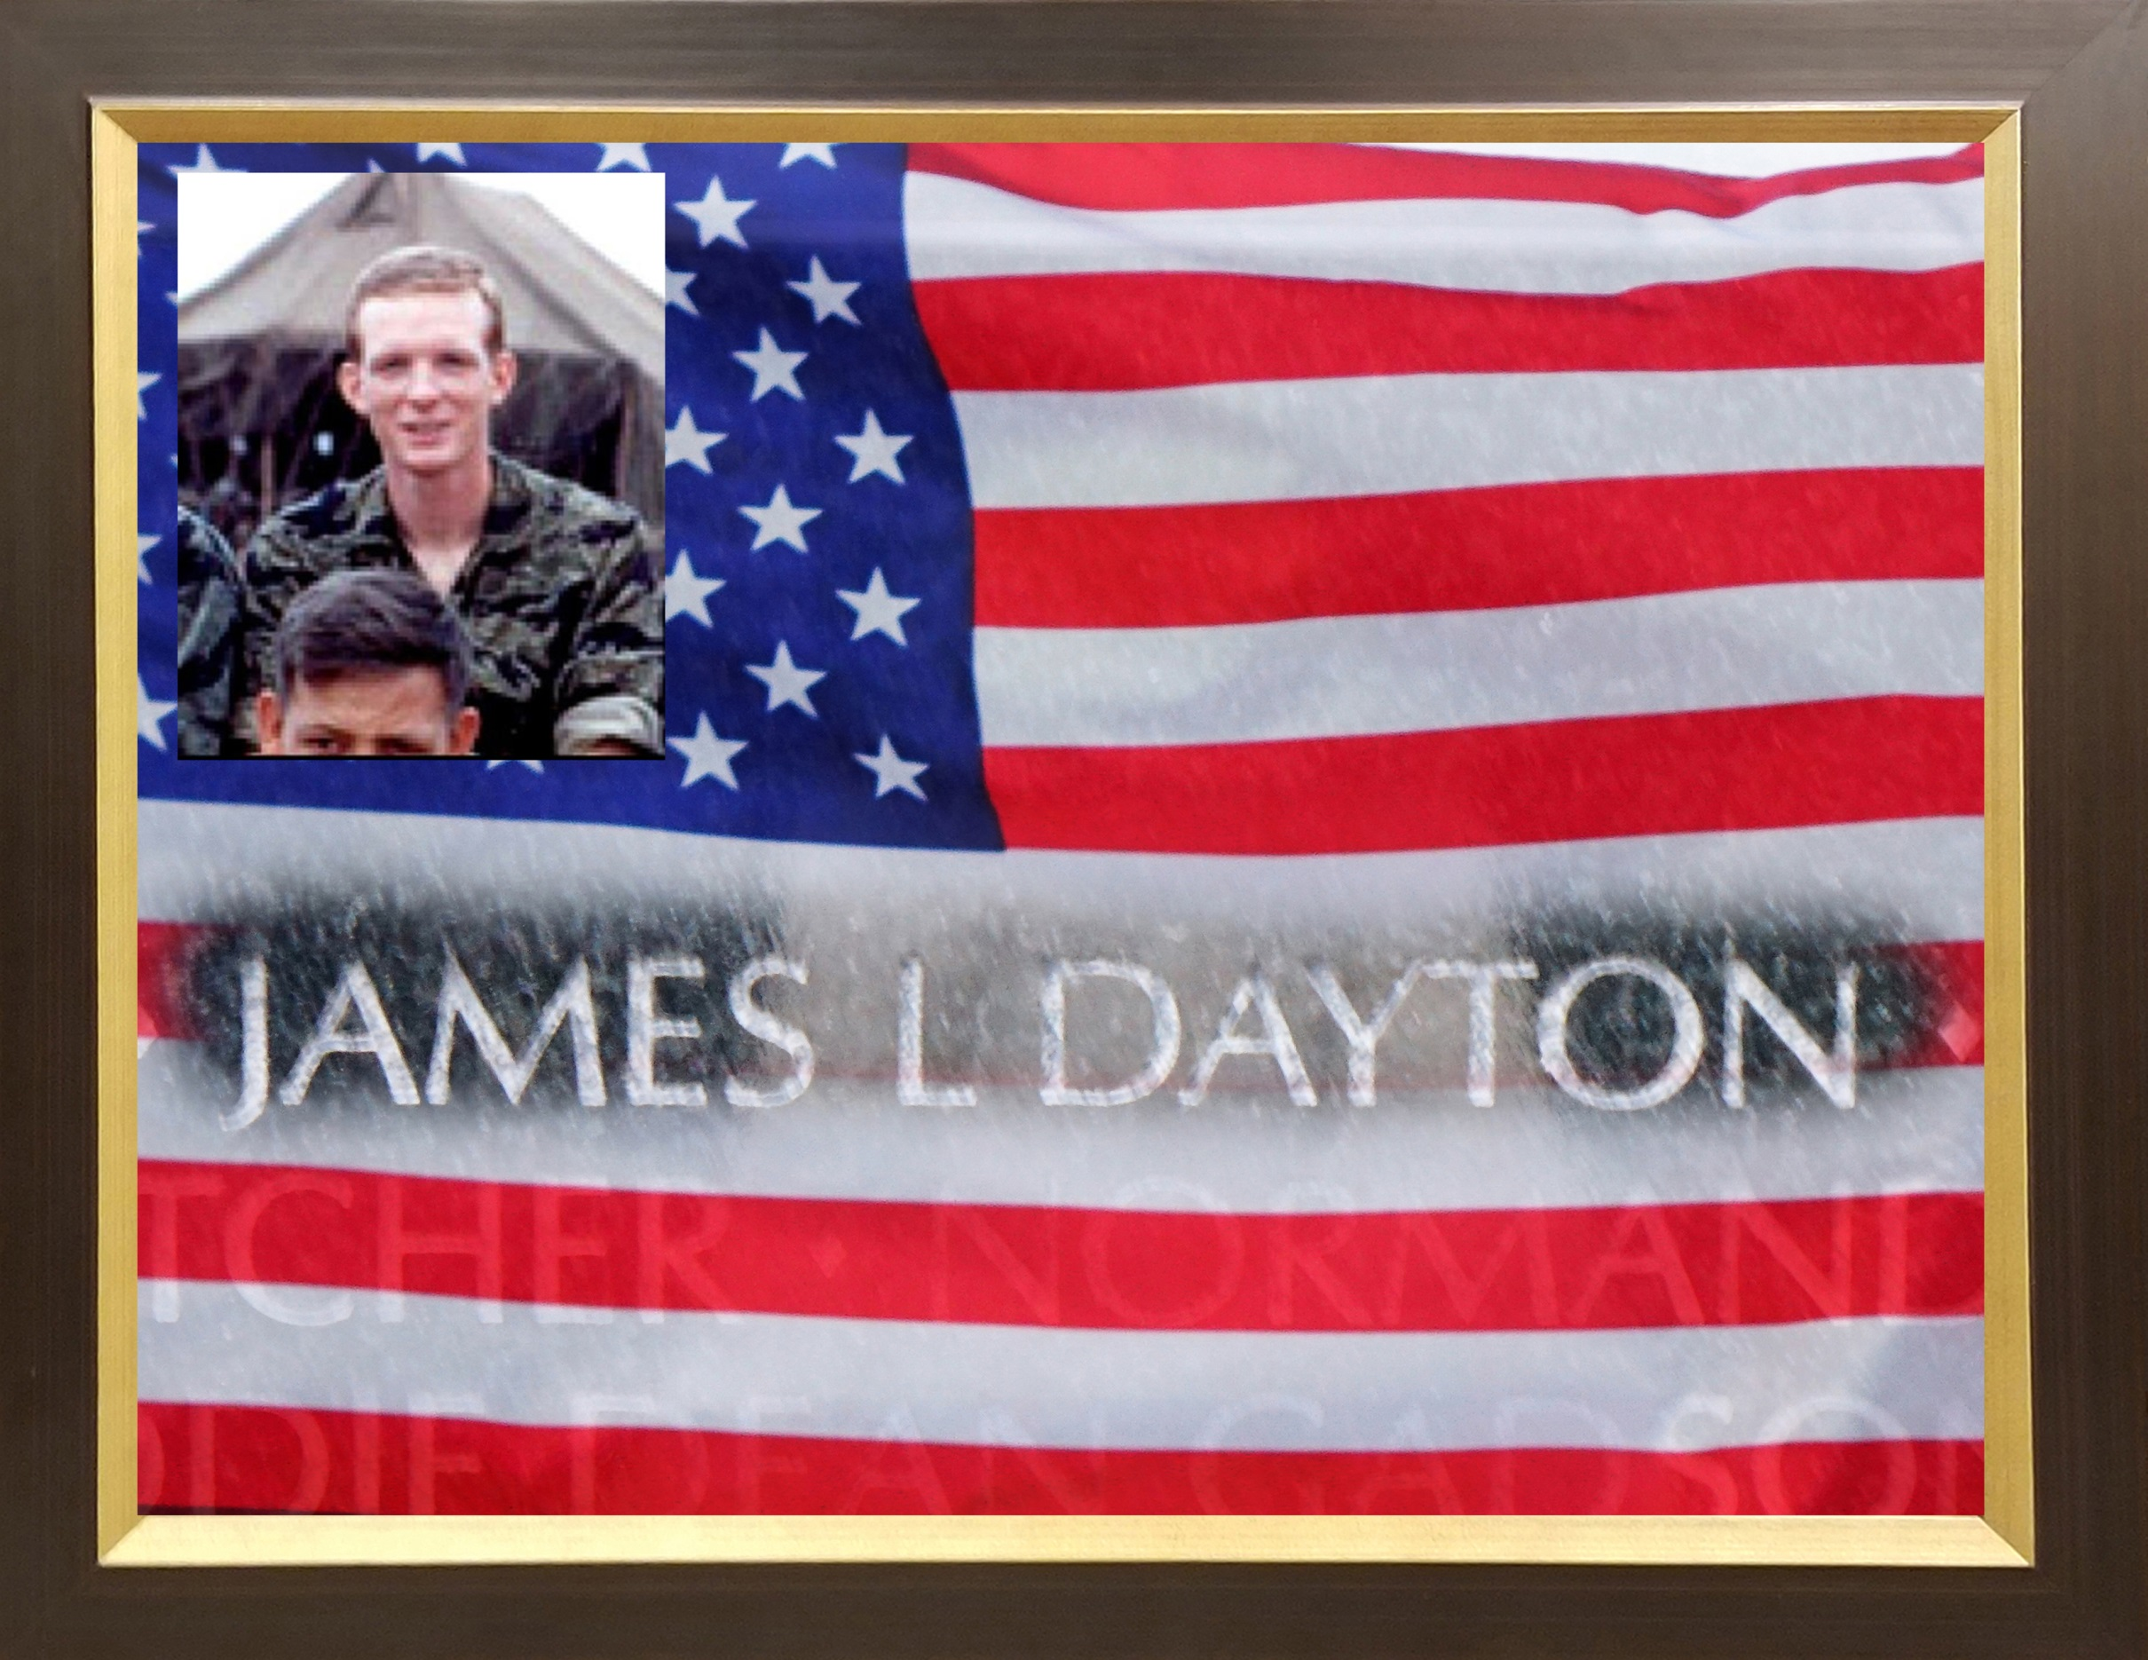

Slide 8
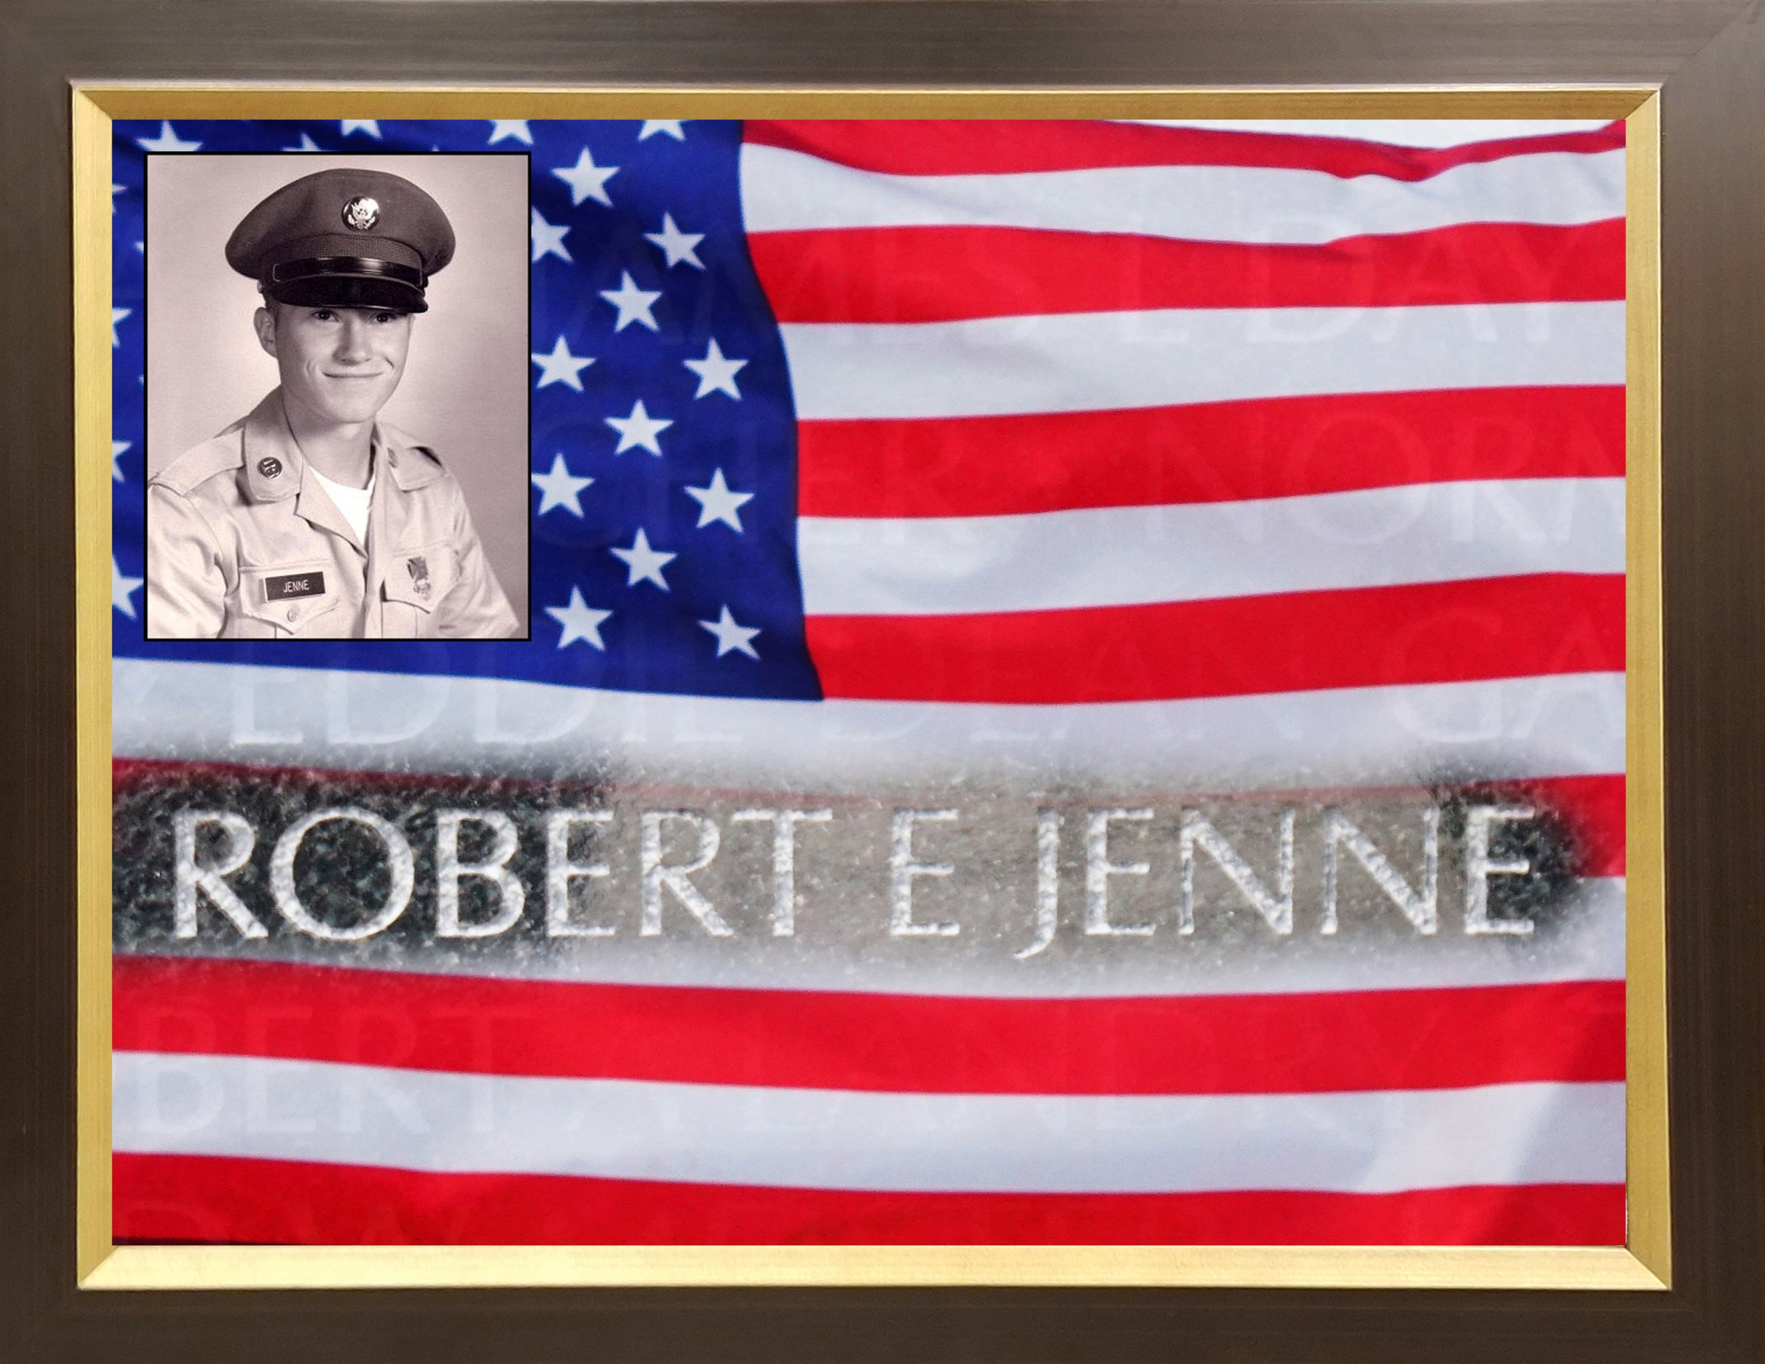

Slide 9
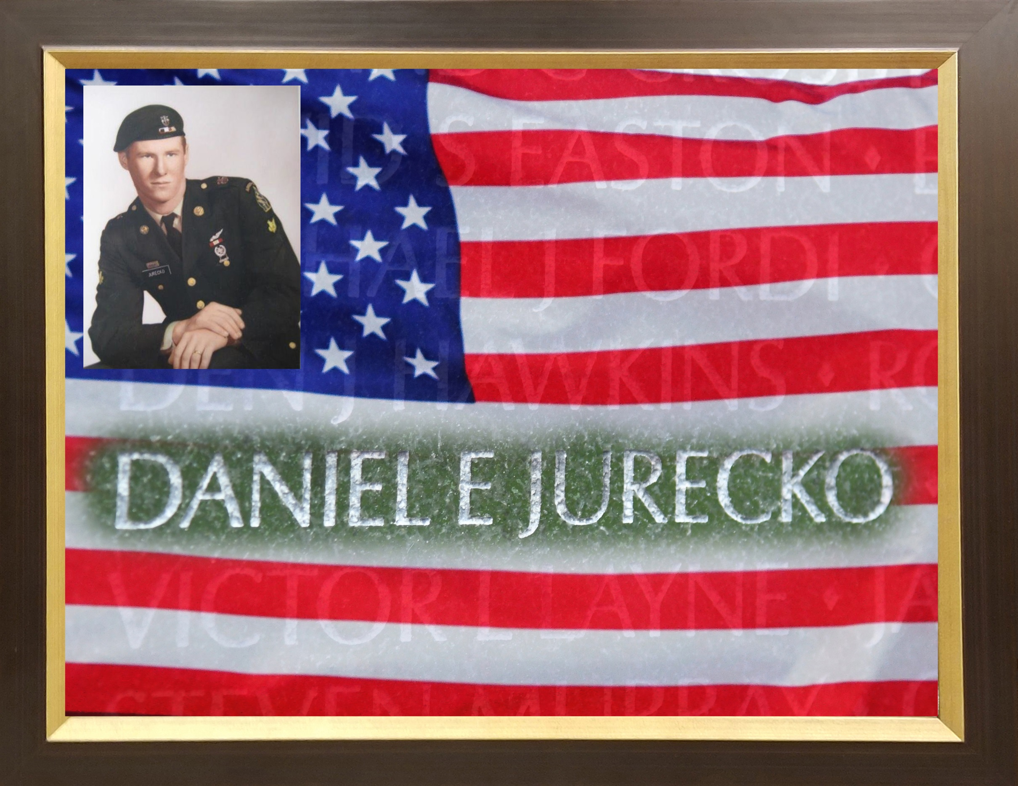

Slide 10
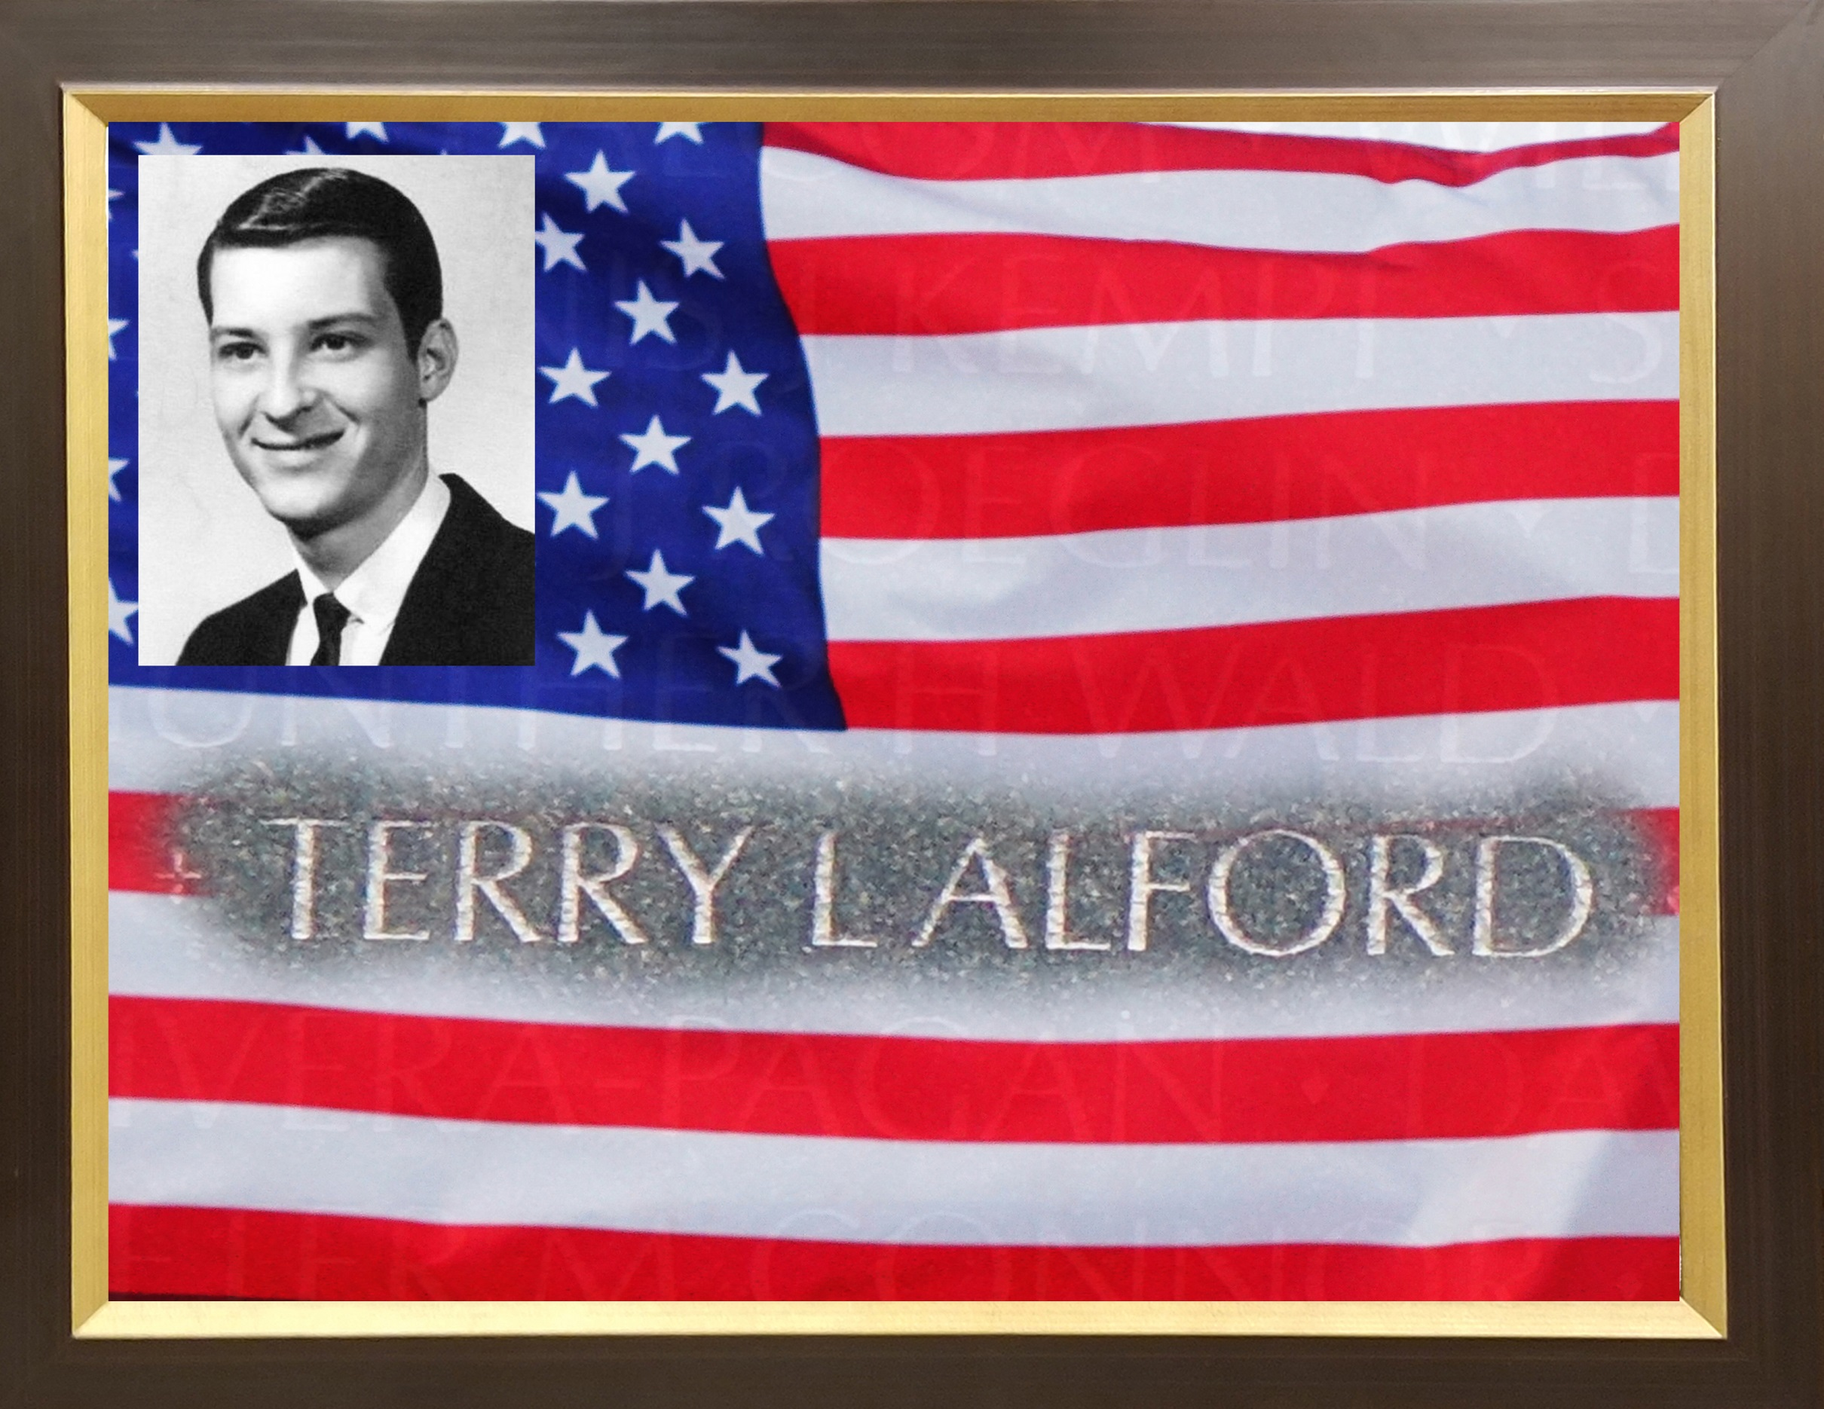

Slide 11
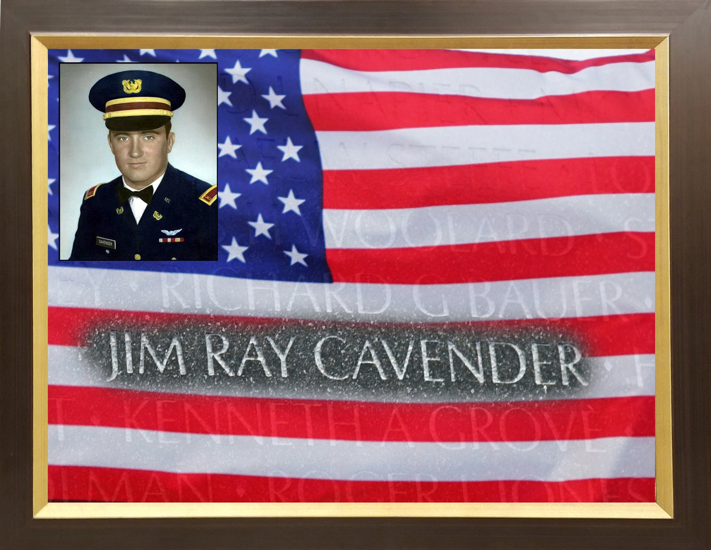

Slide 12
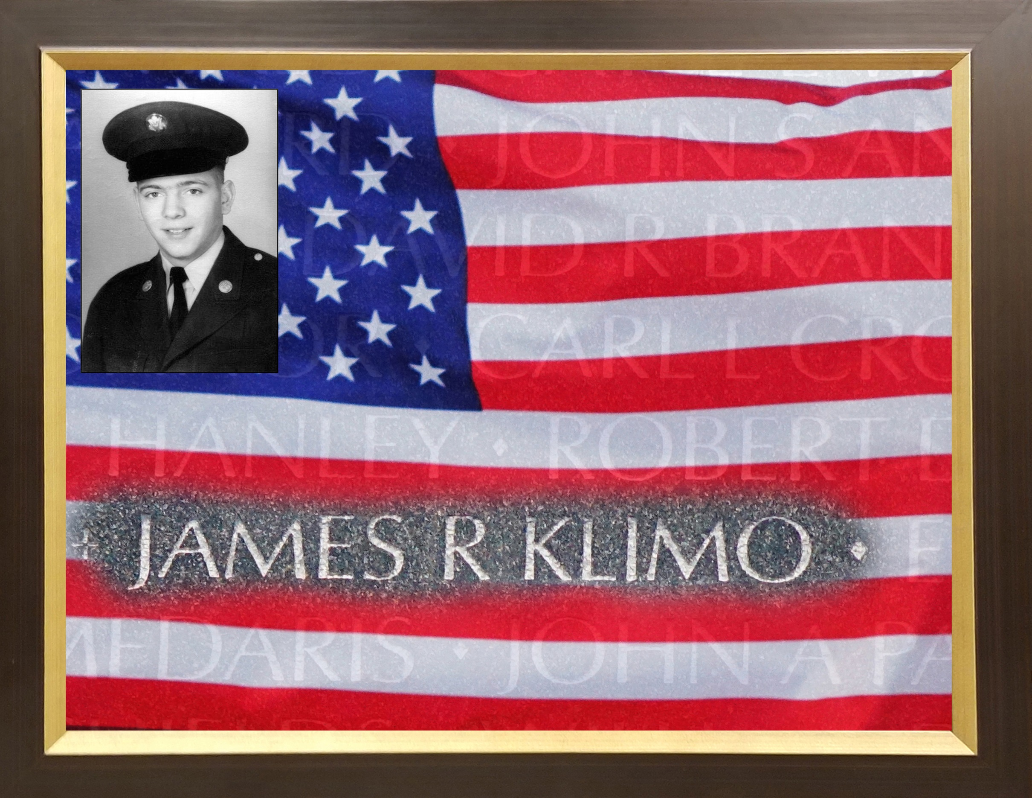

Slide 13
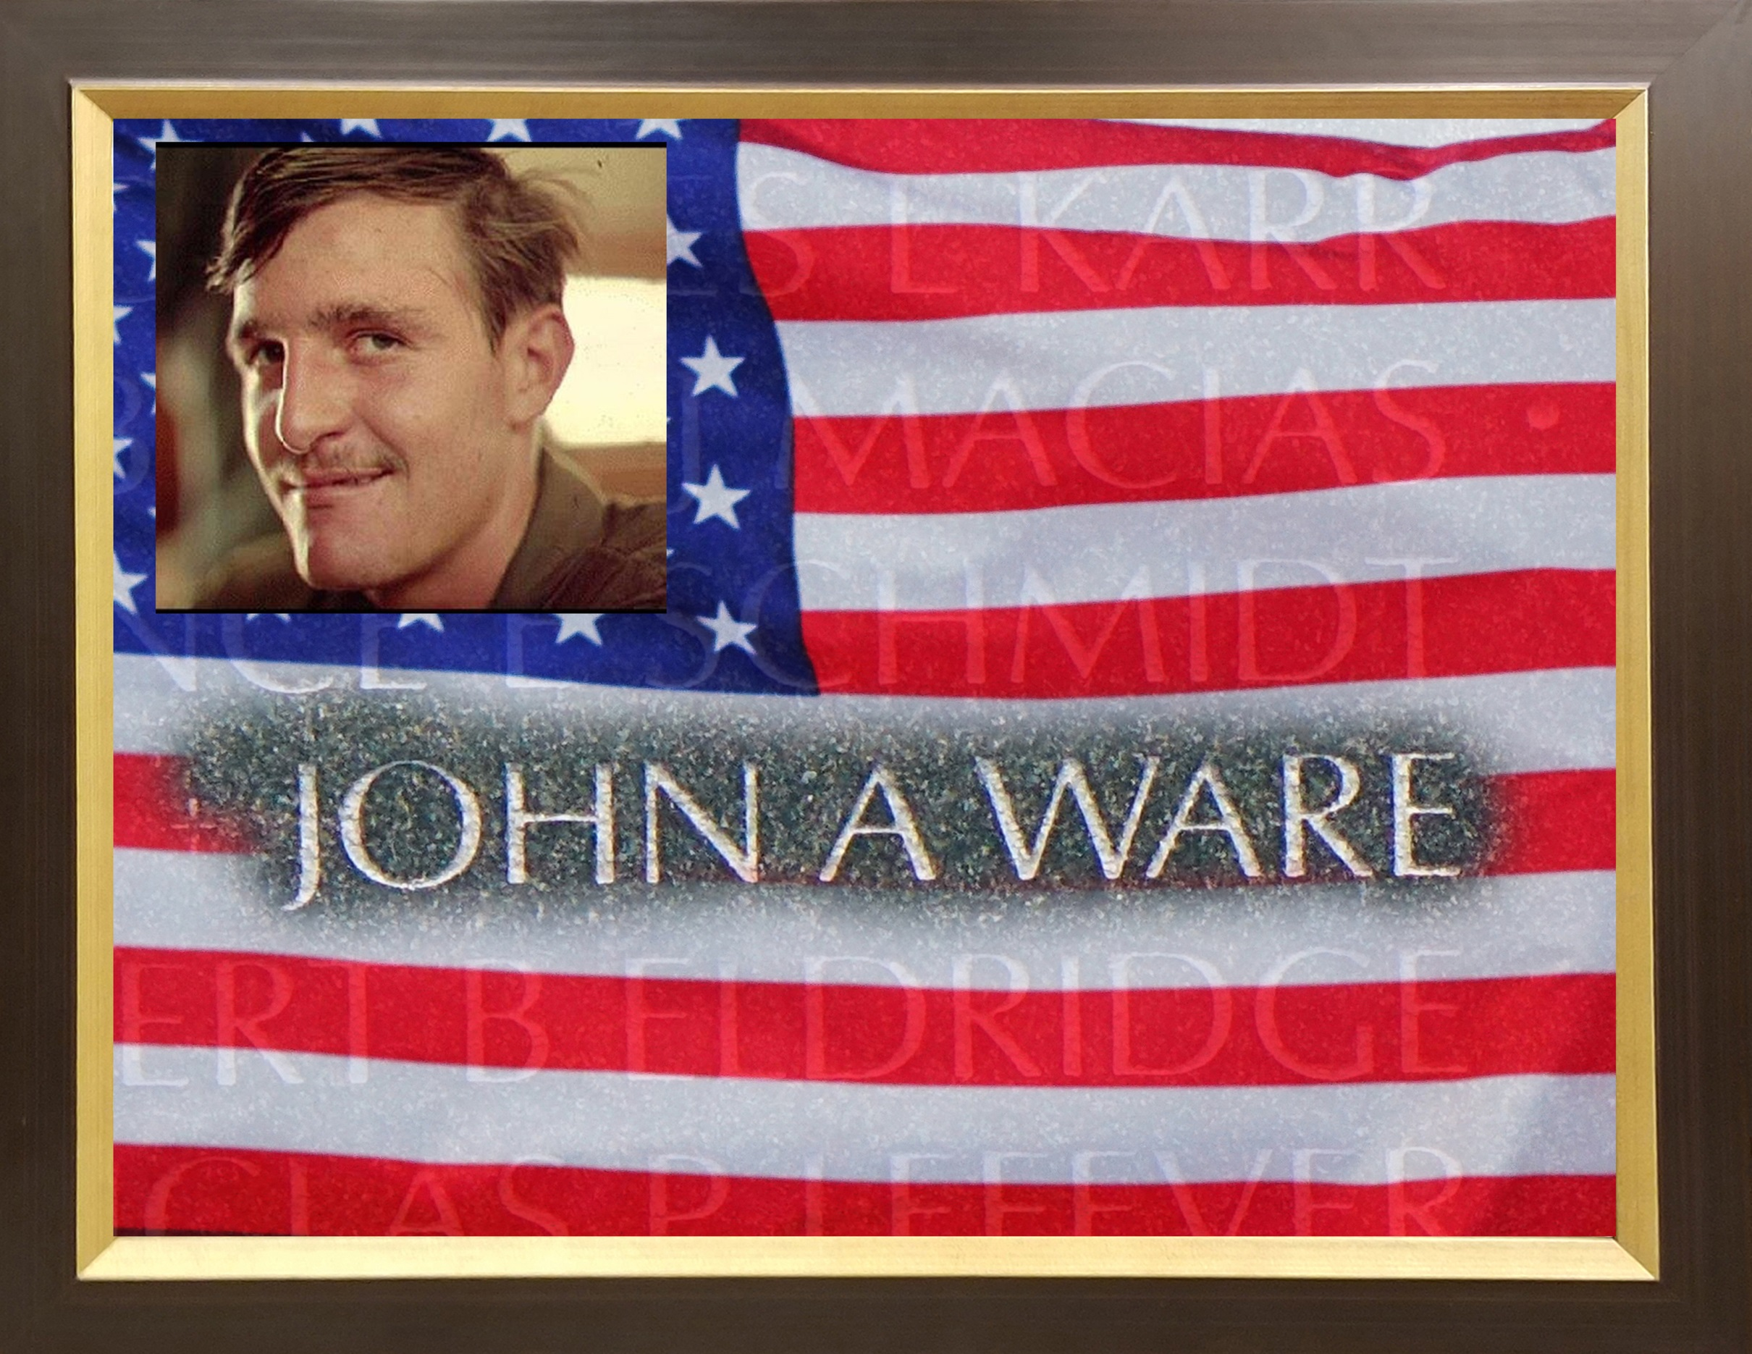

Slide 14
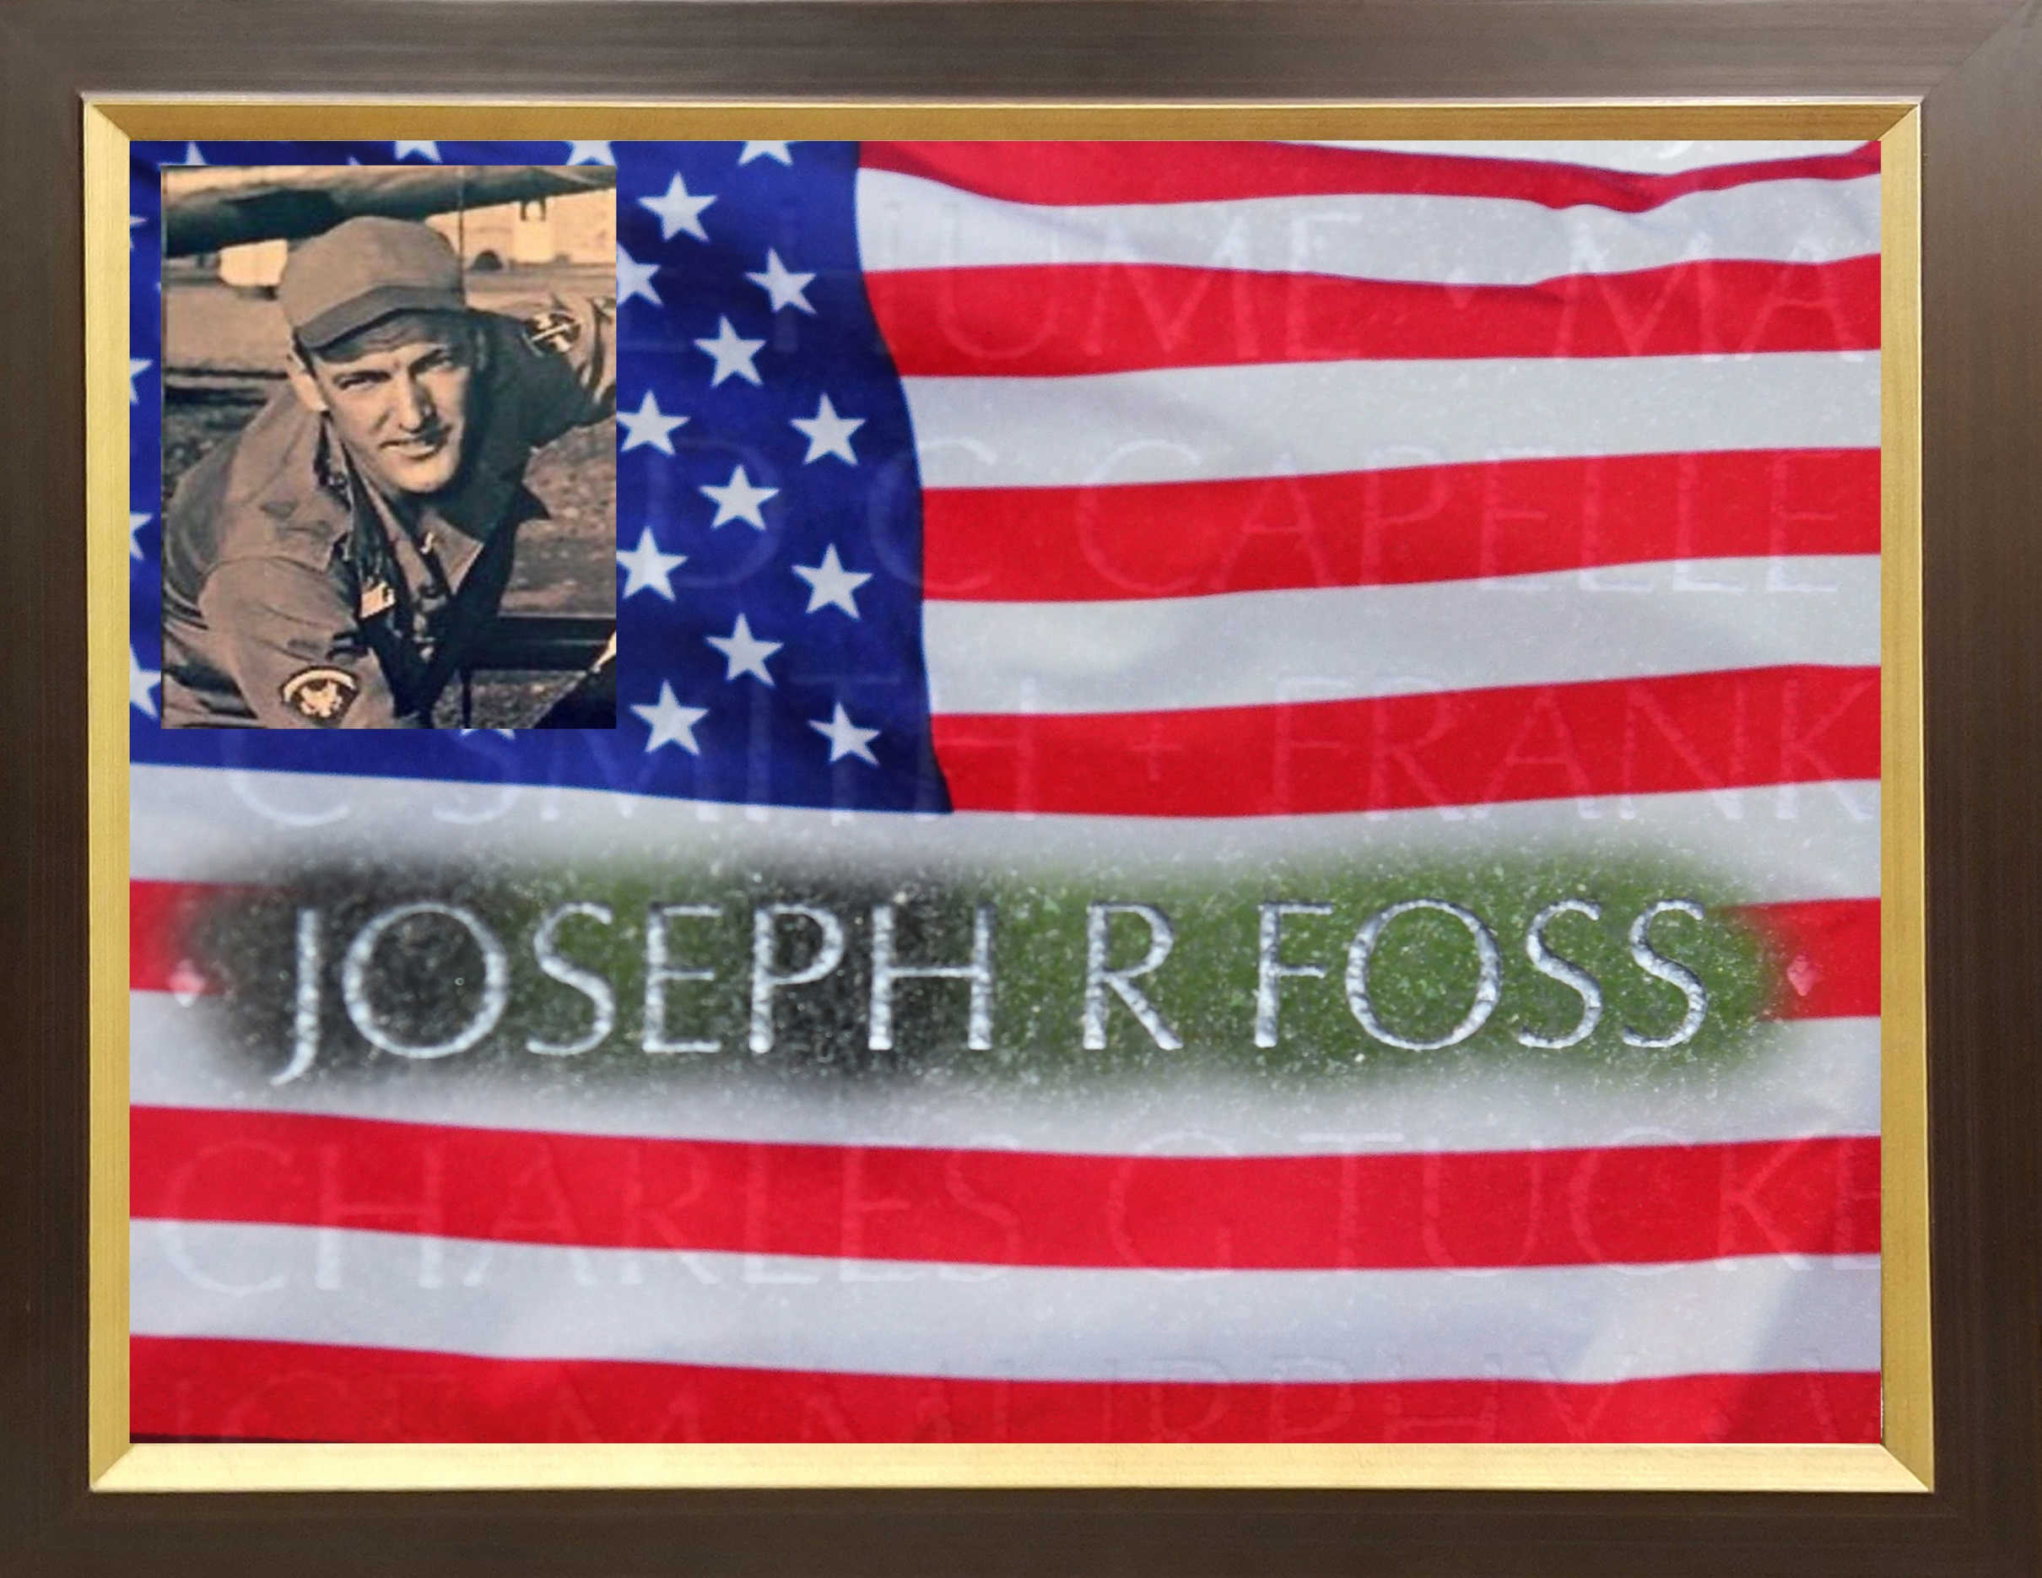

Slide 15


Slide 16


Slide 17
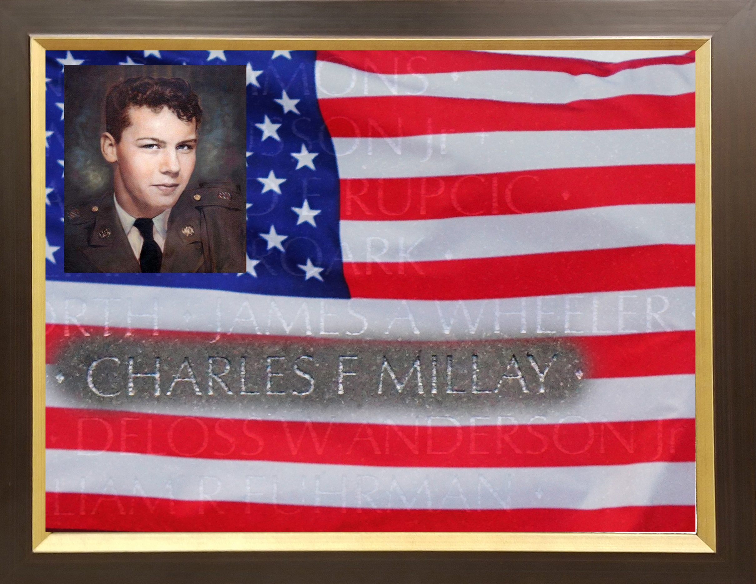

Slide 18
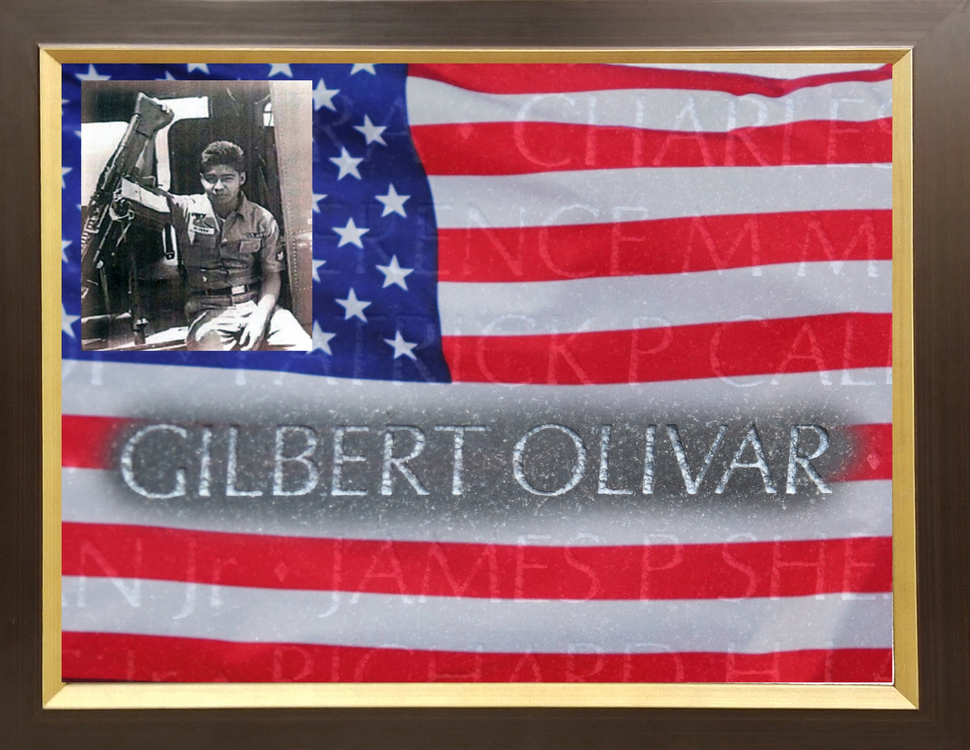

Slide 19
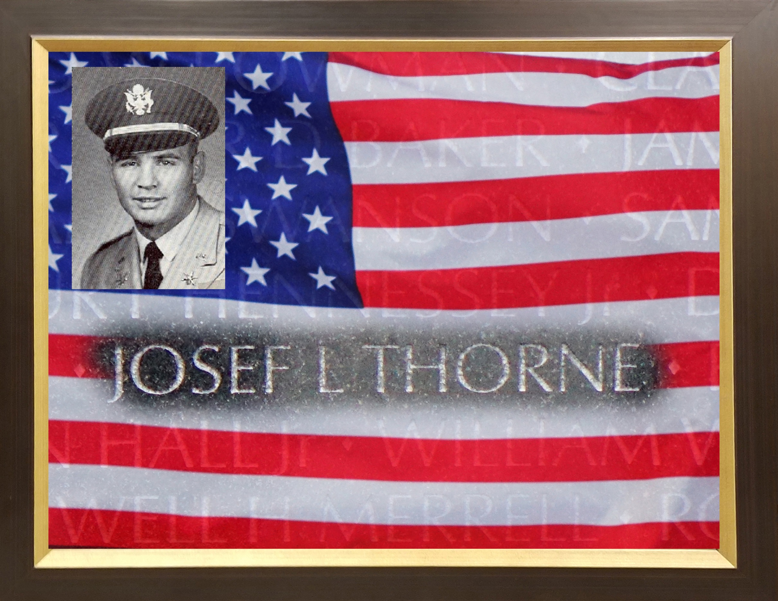

Slide 20
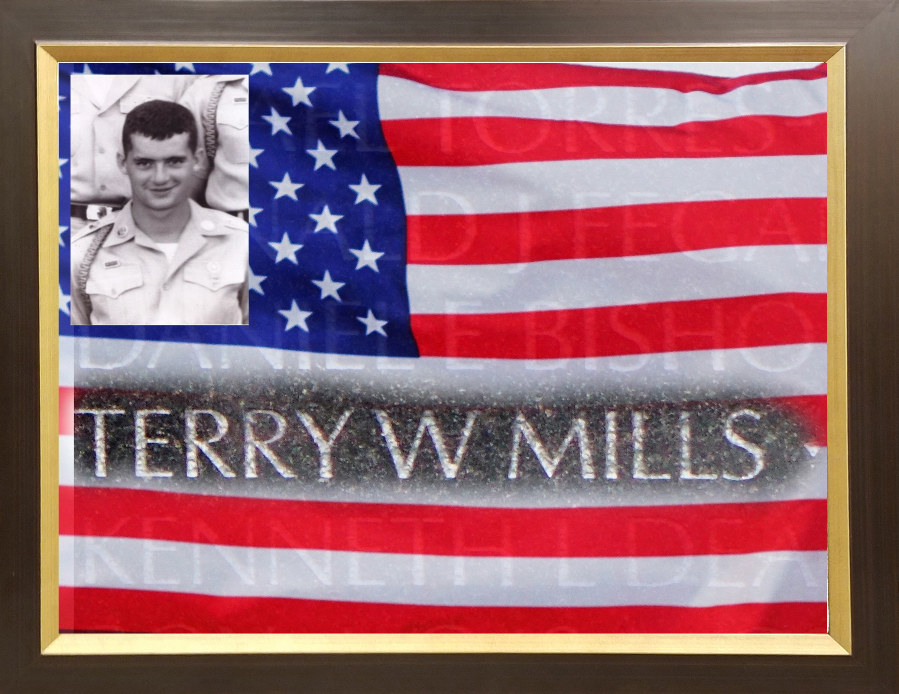

Slide 21
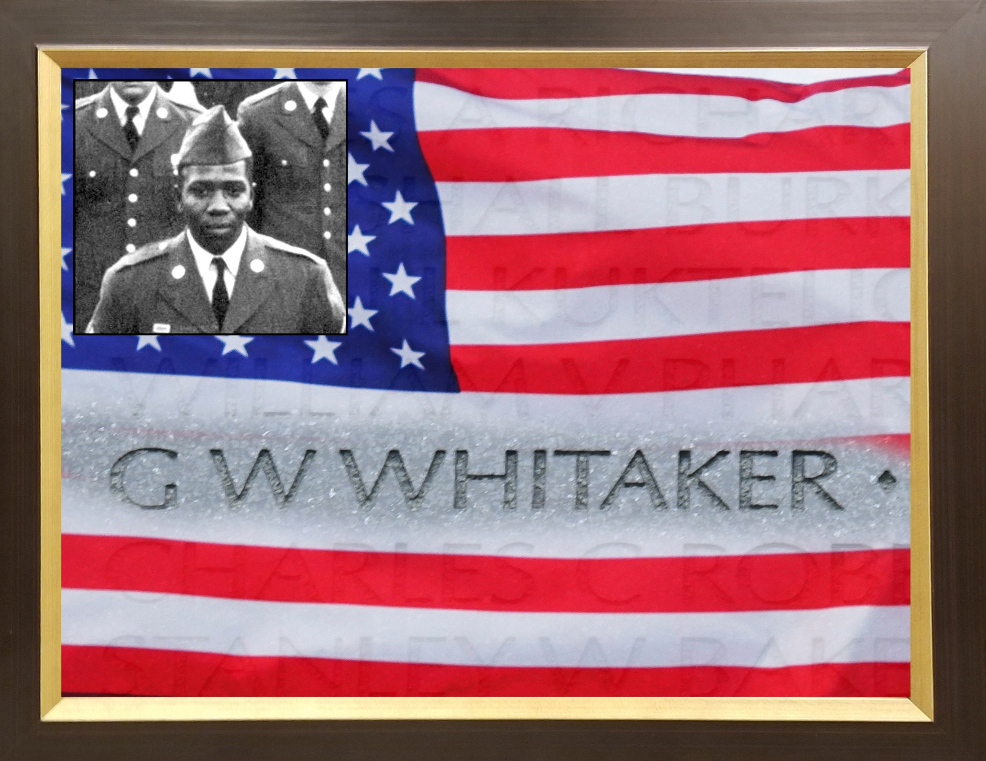

Slide 22


Slide 23
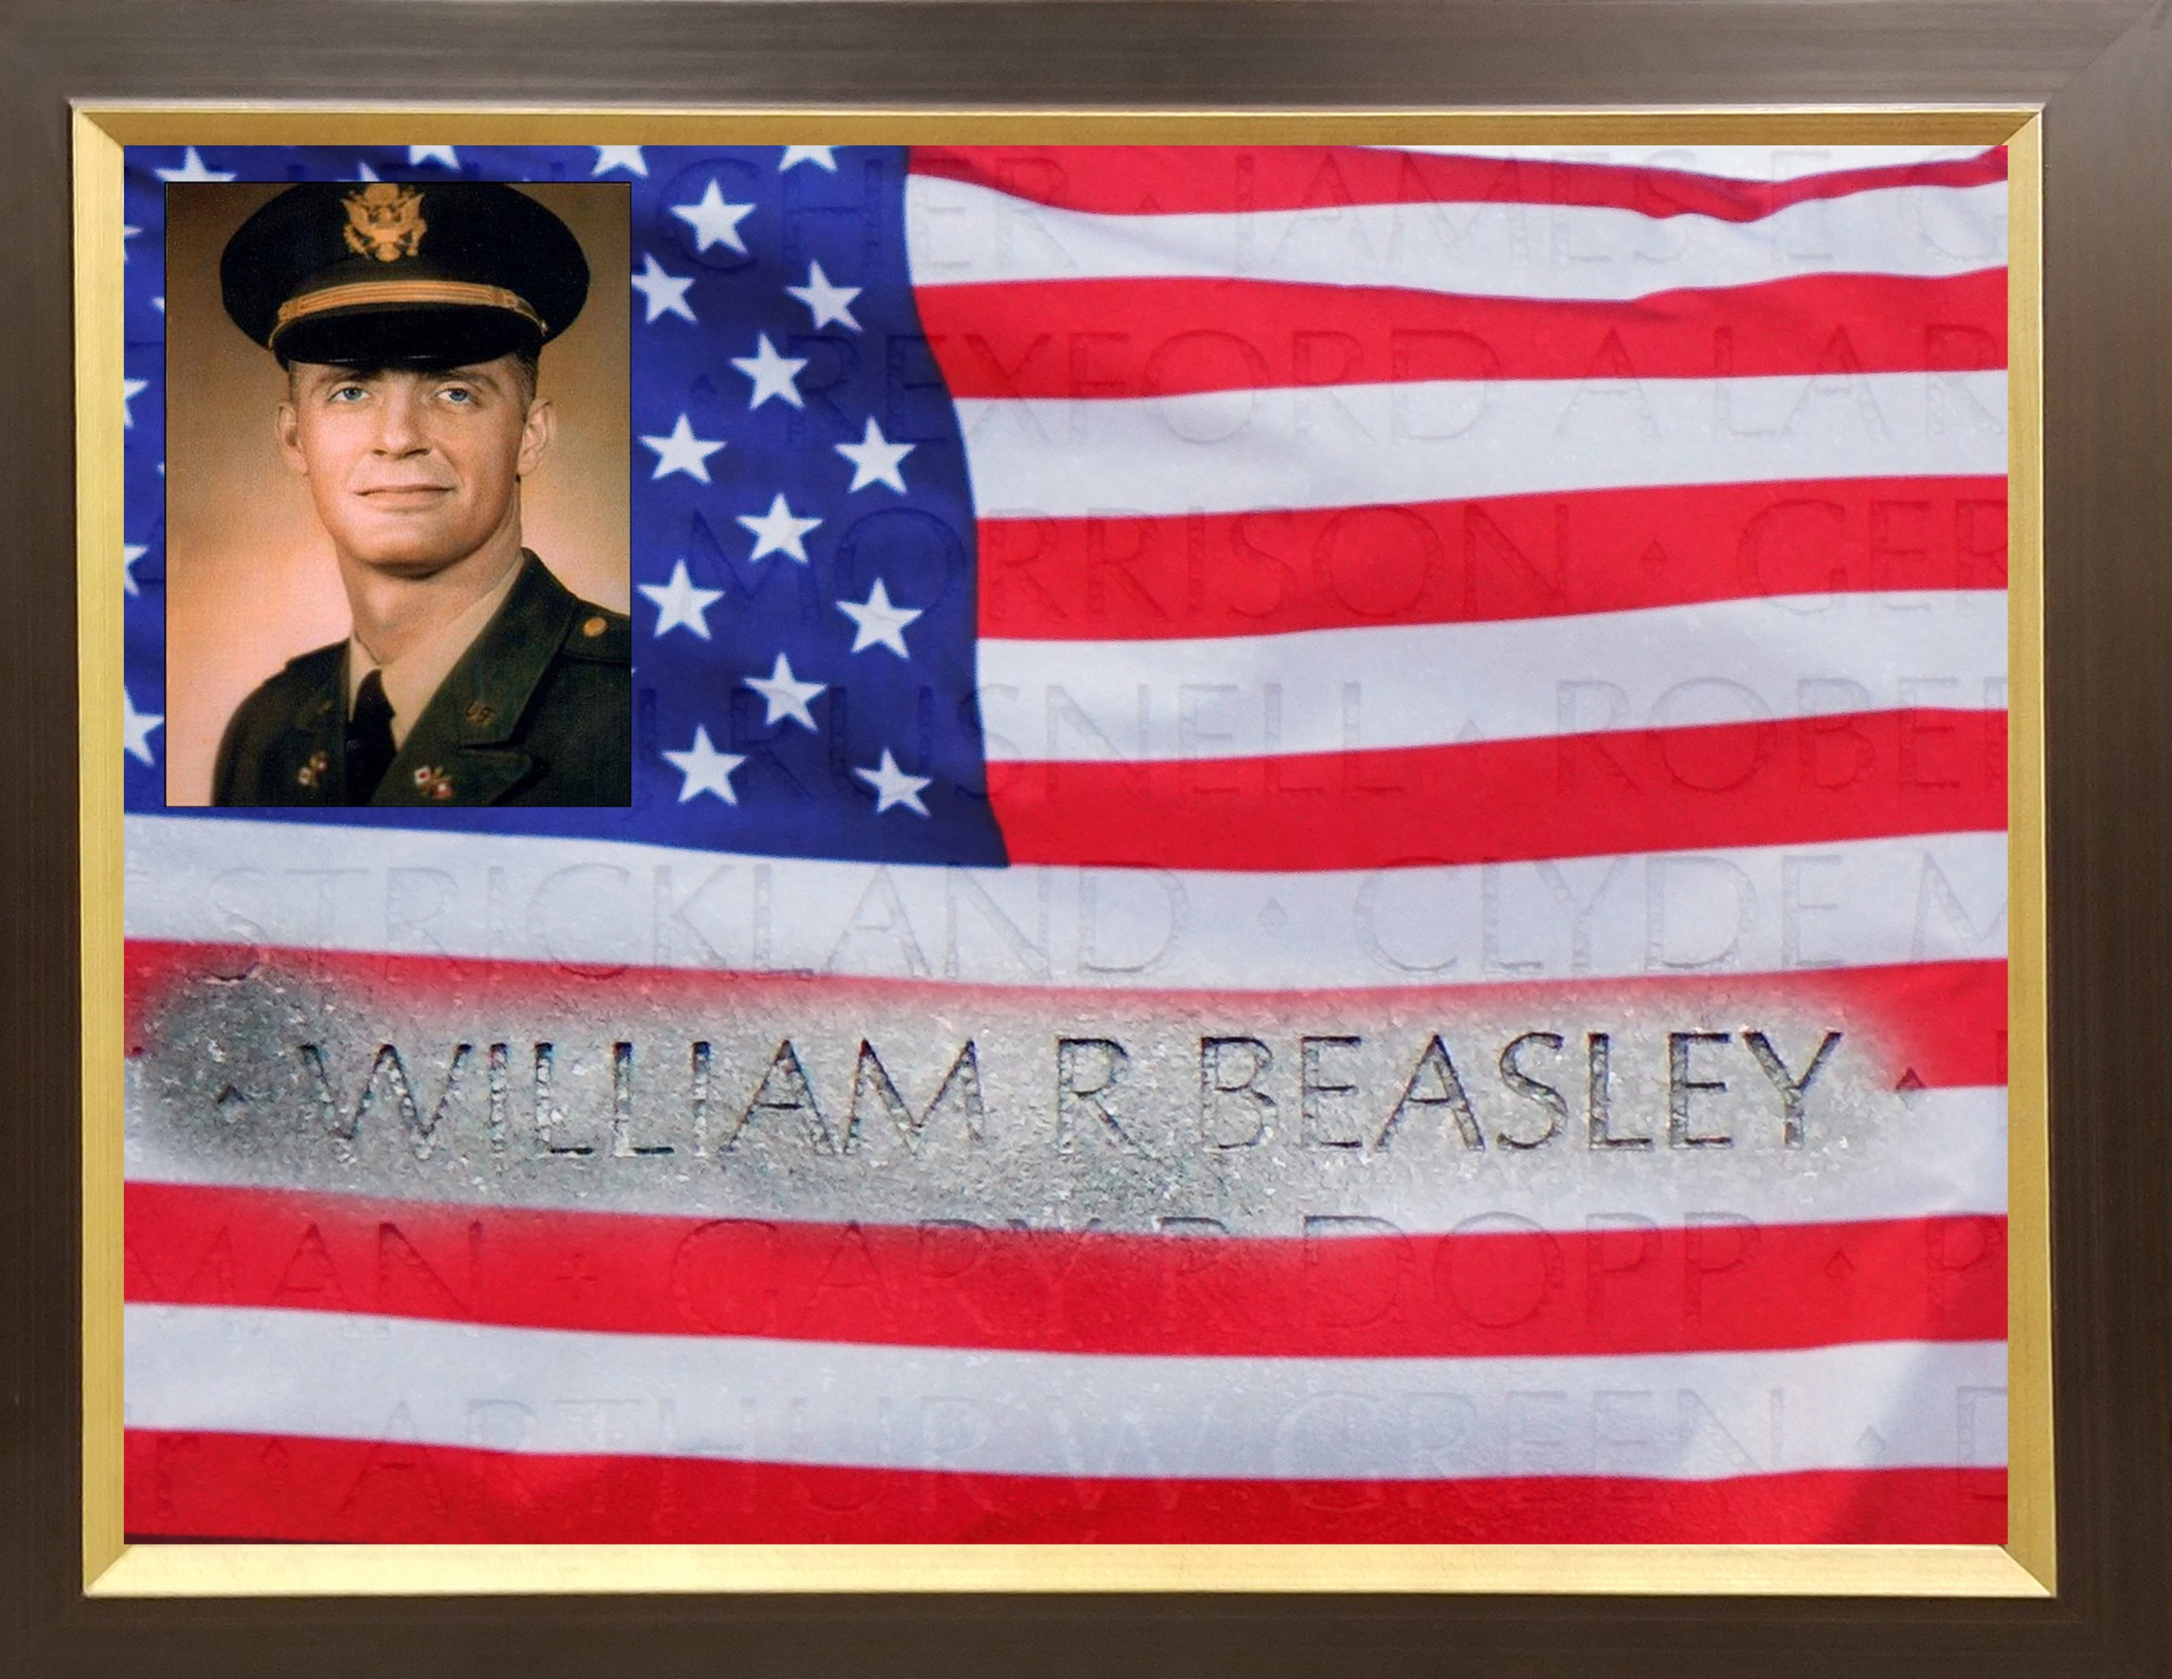

Slide 24
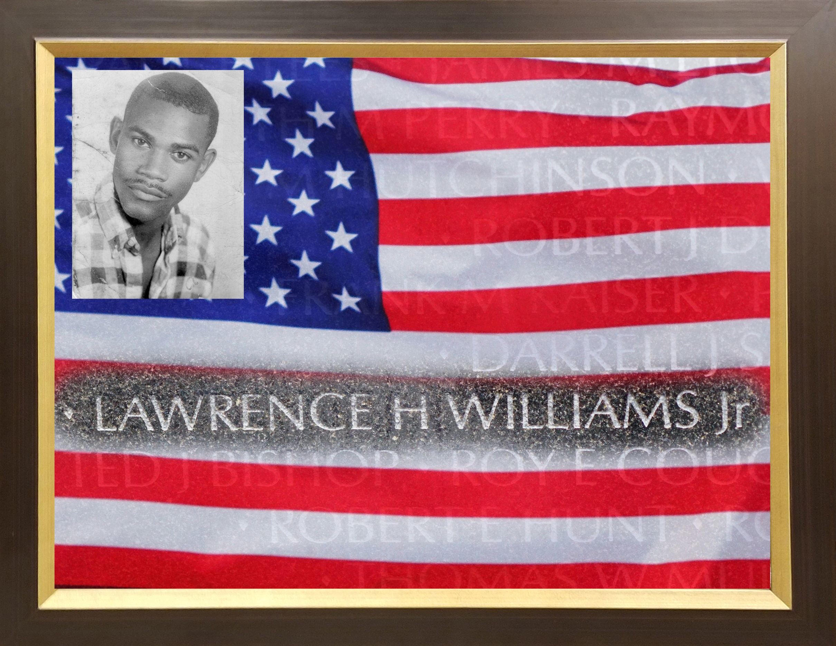

Slide 25
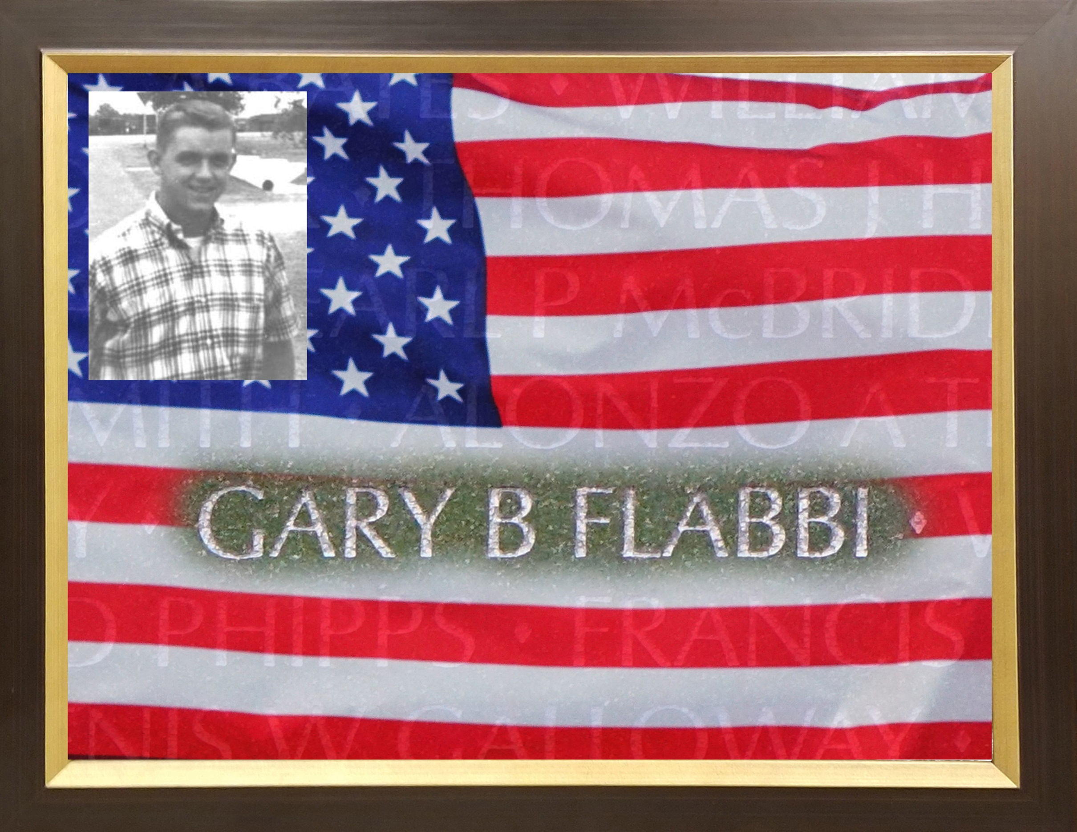

Slide 26
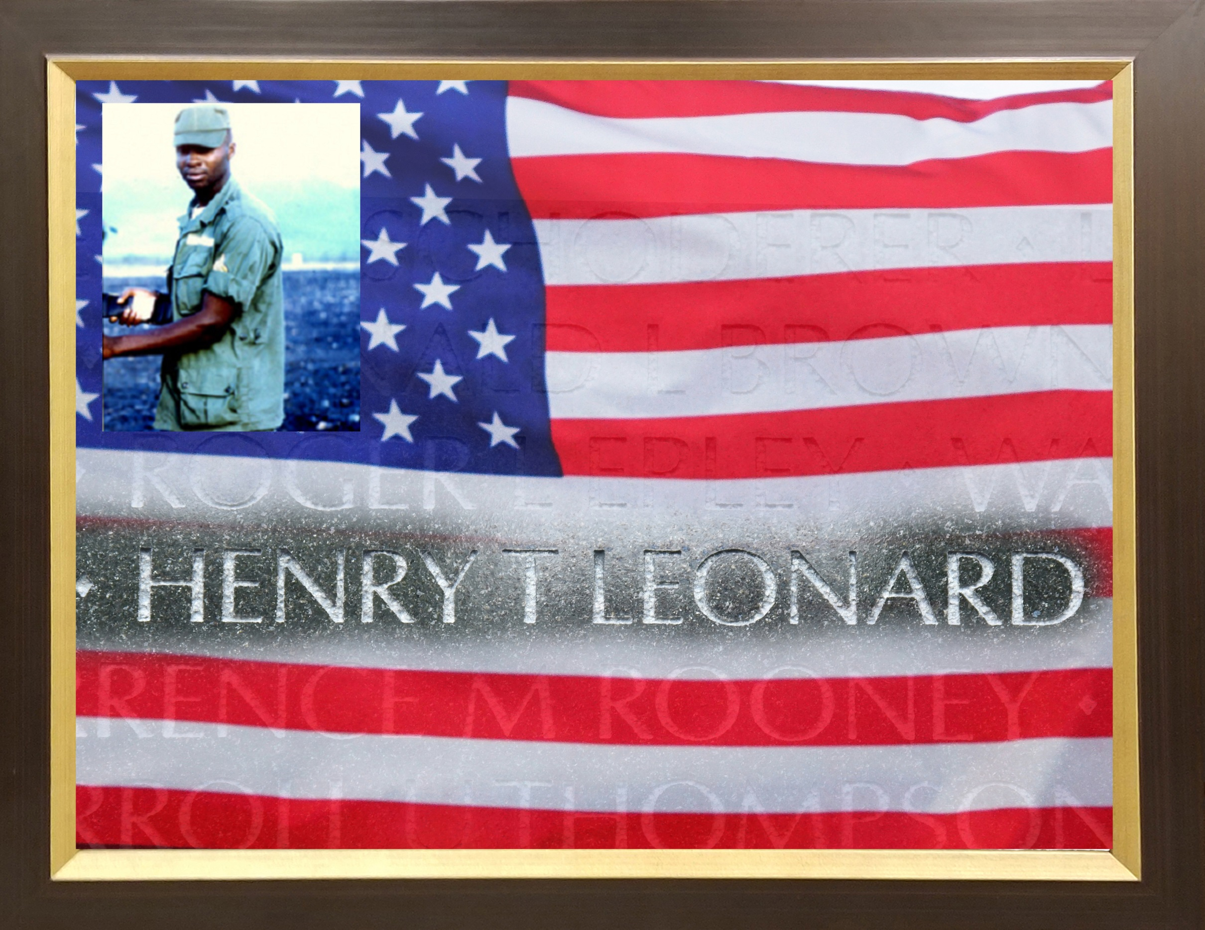

Slide 27
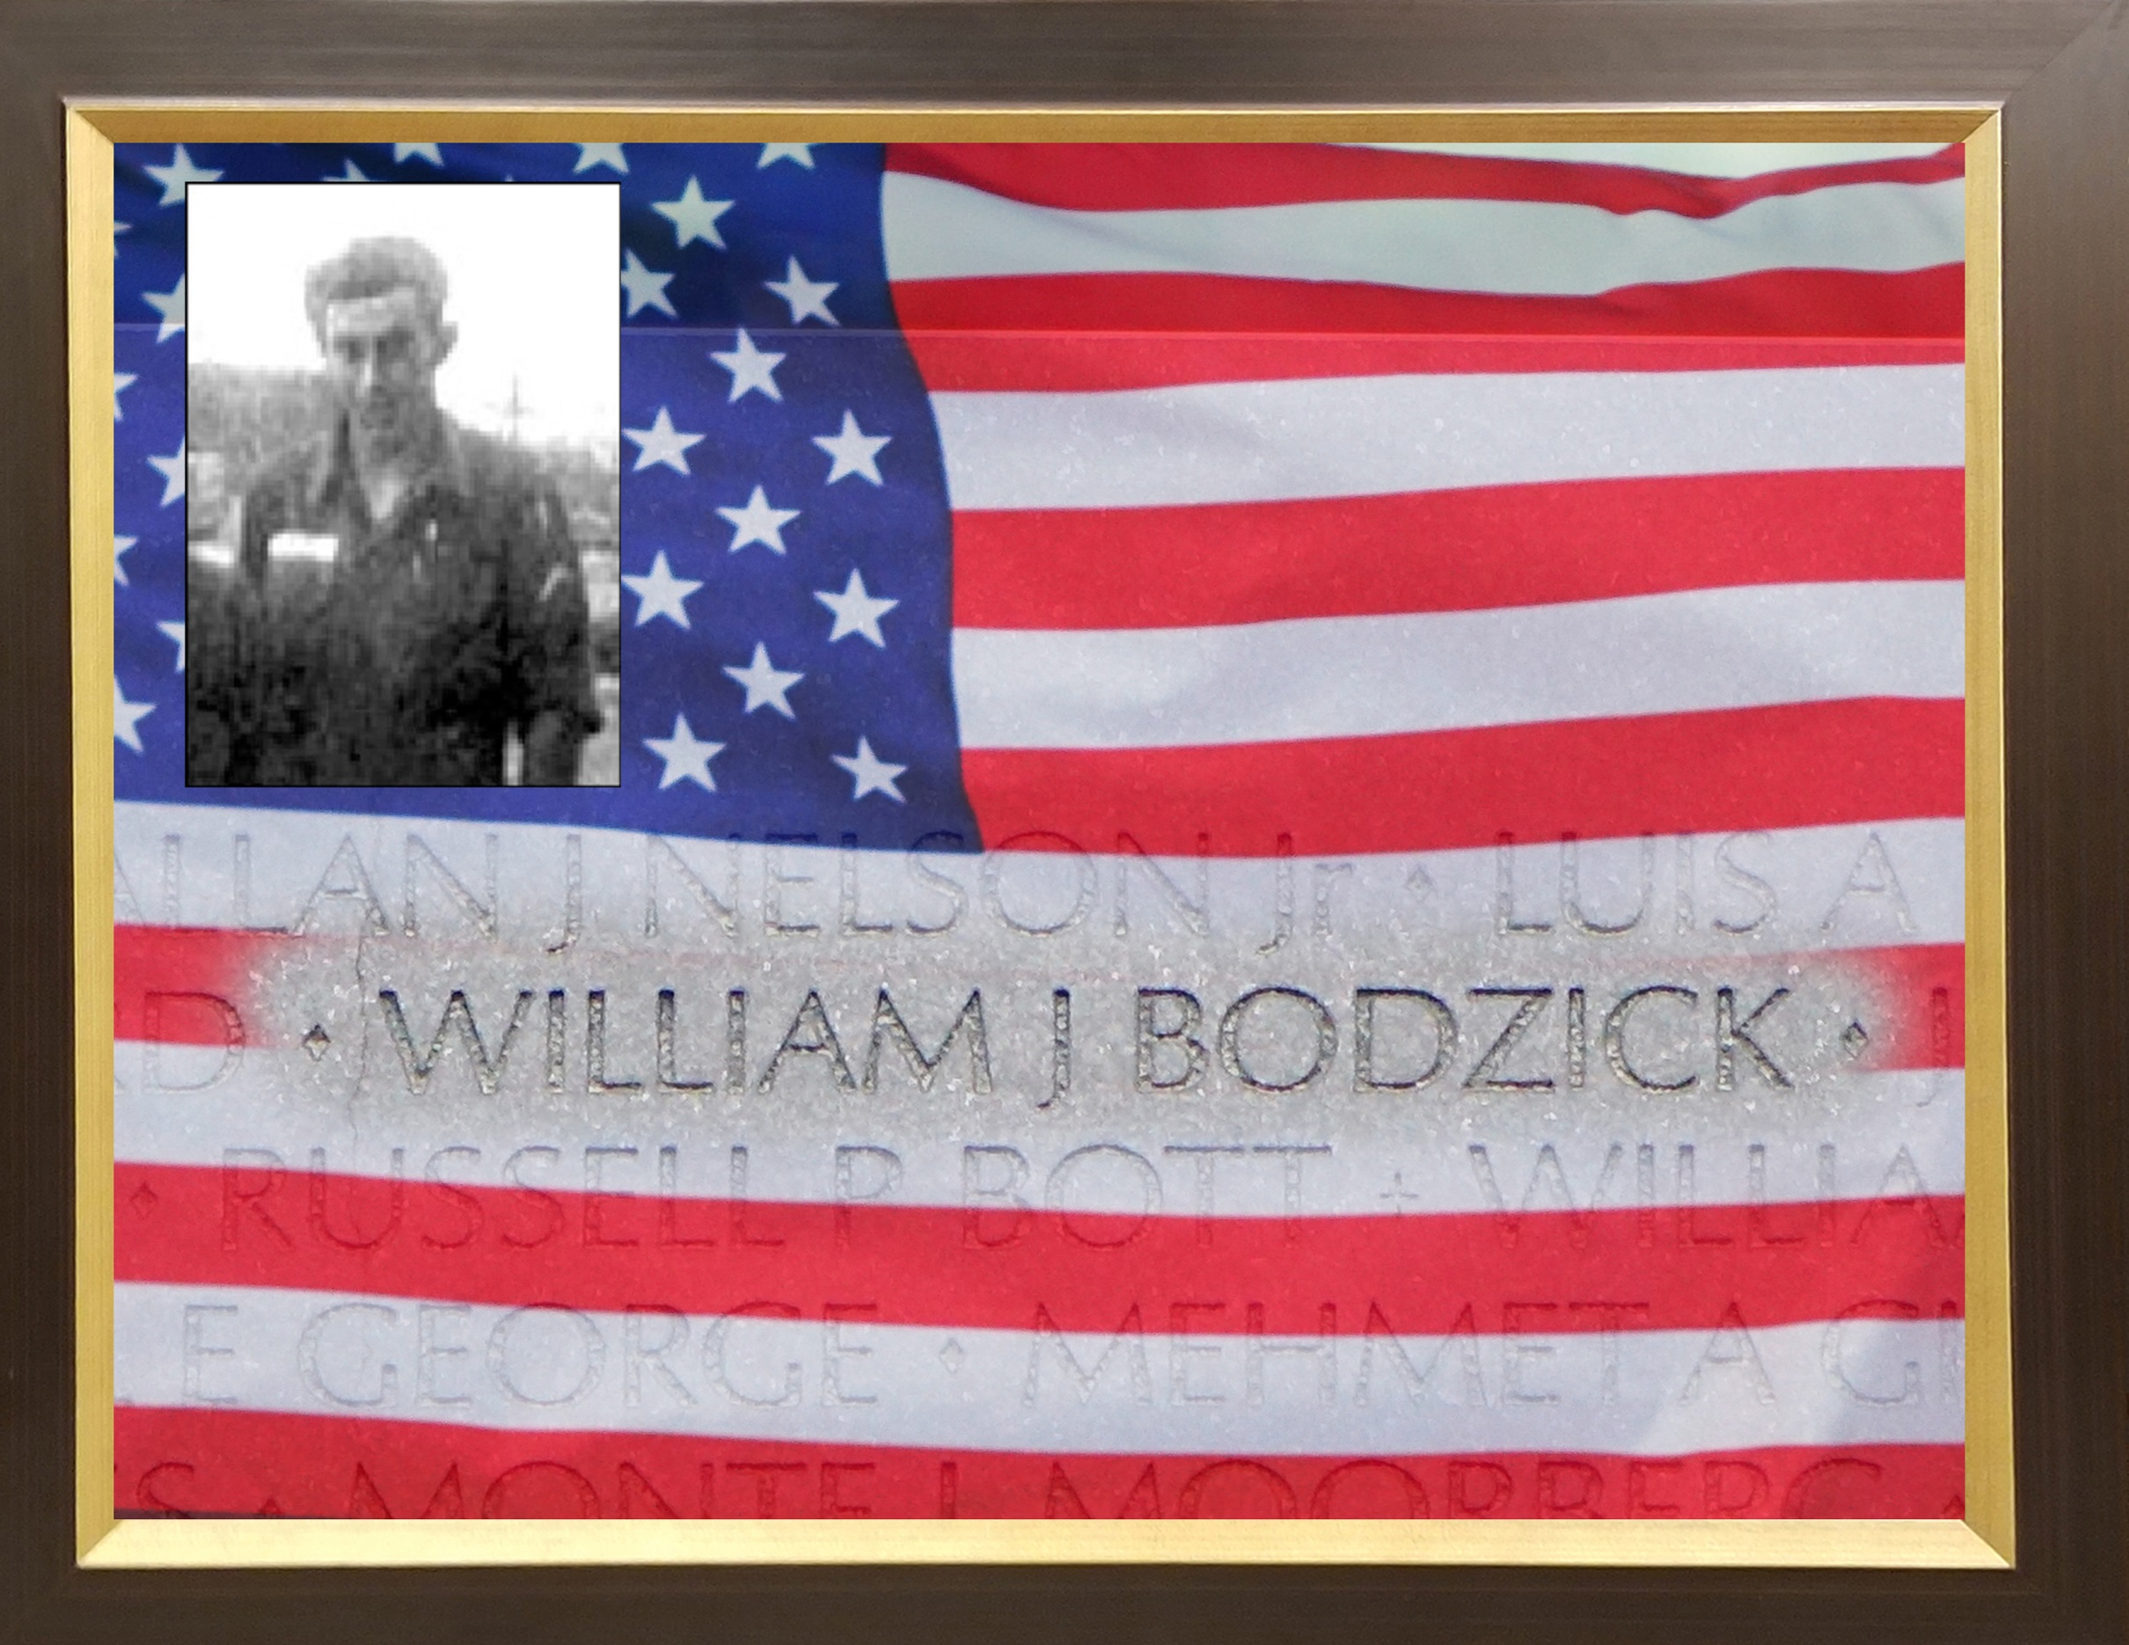

Slide 28
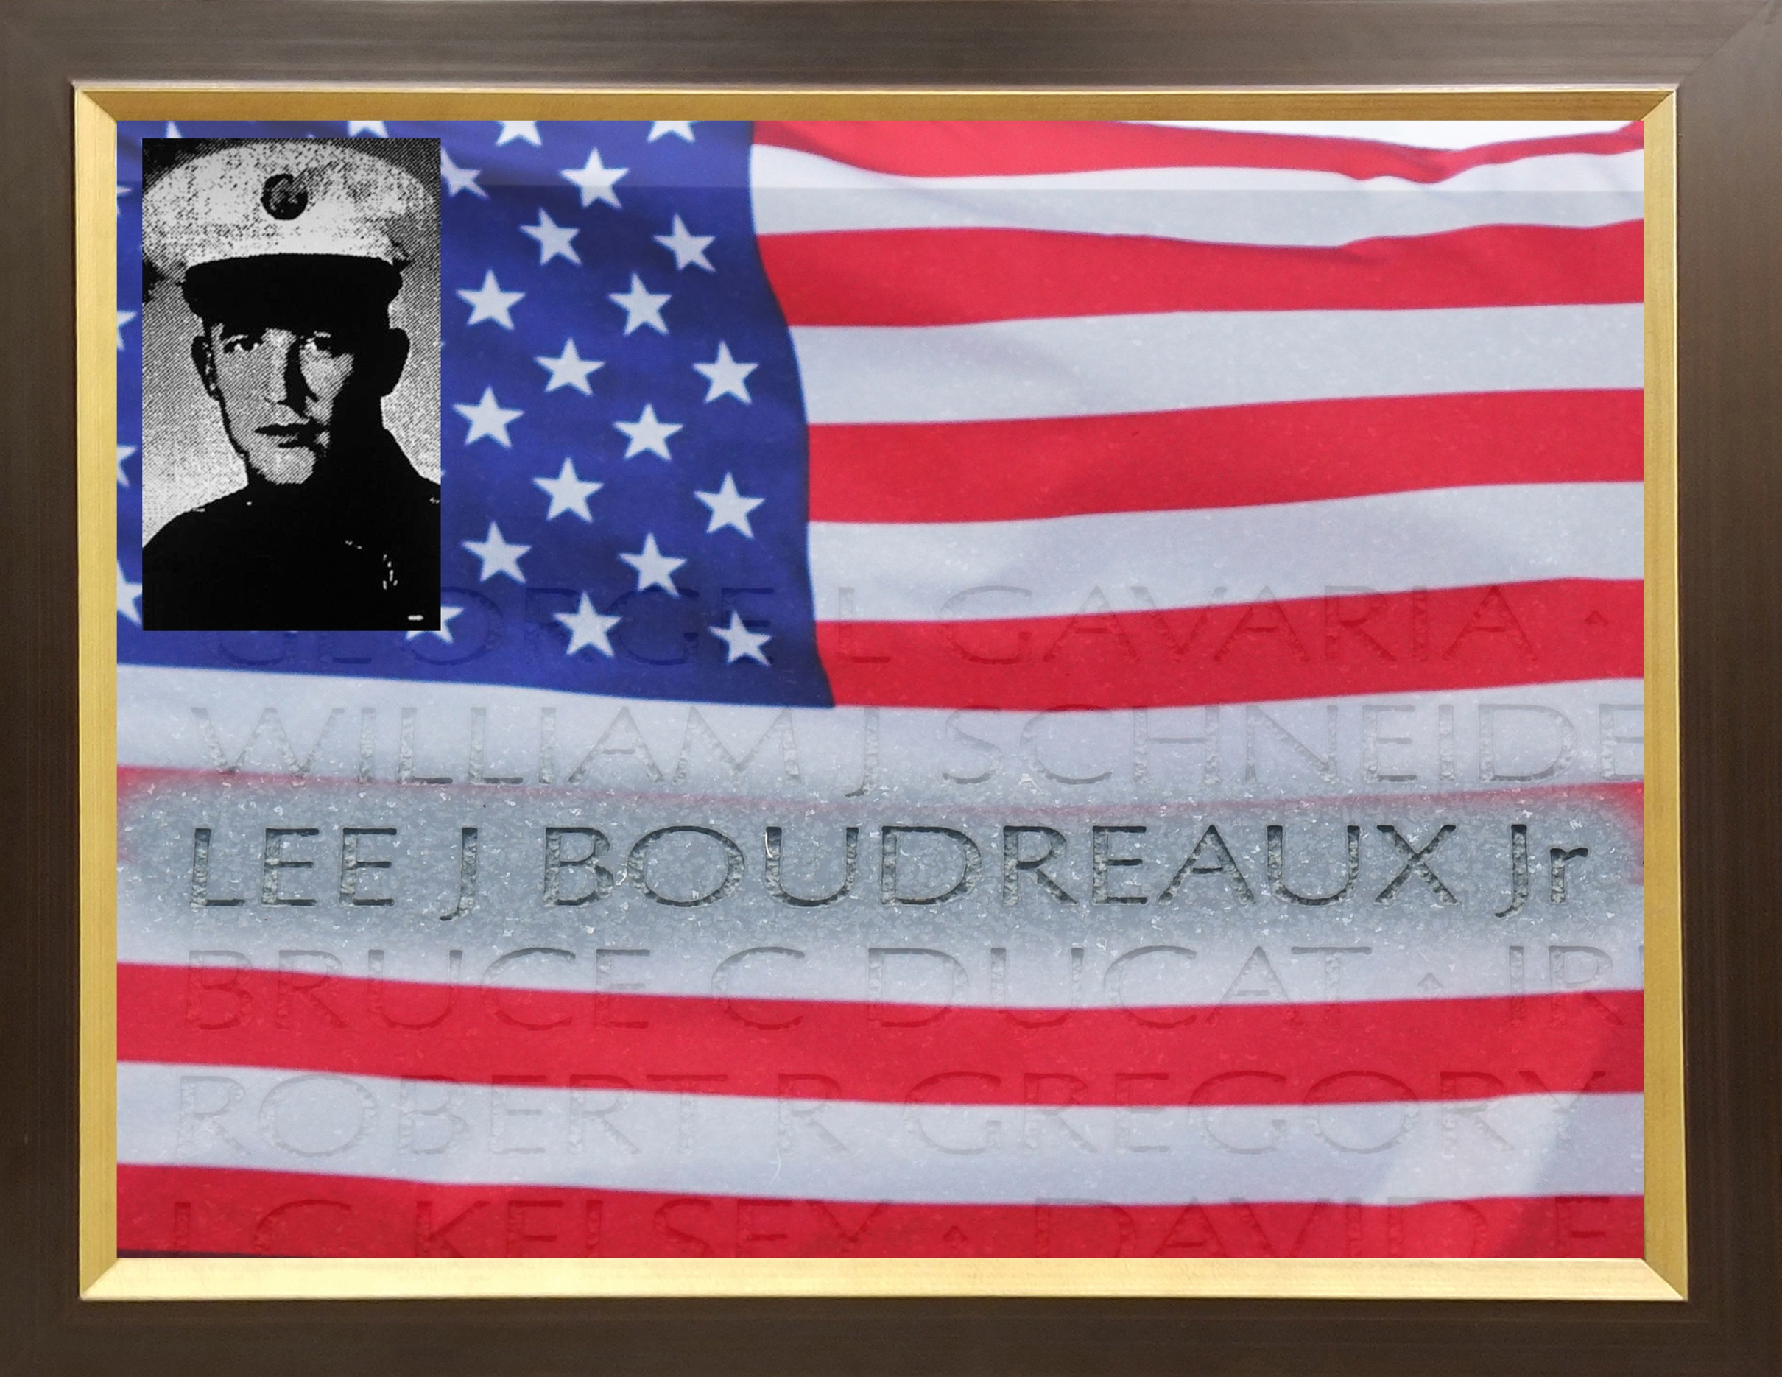

Slide 29
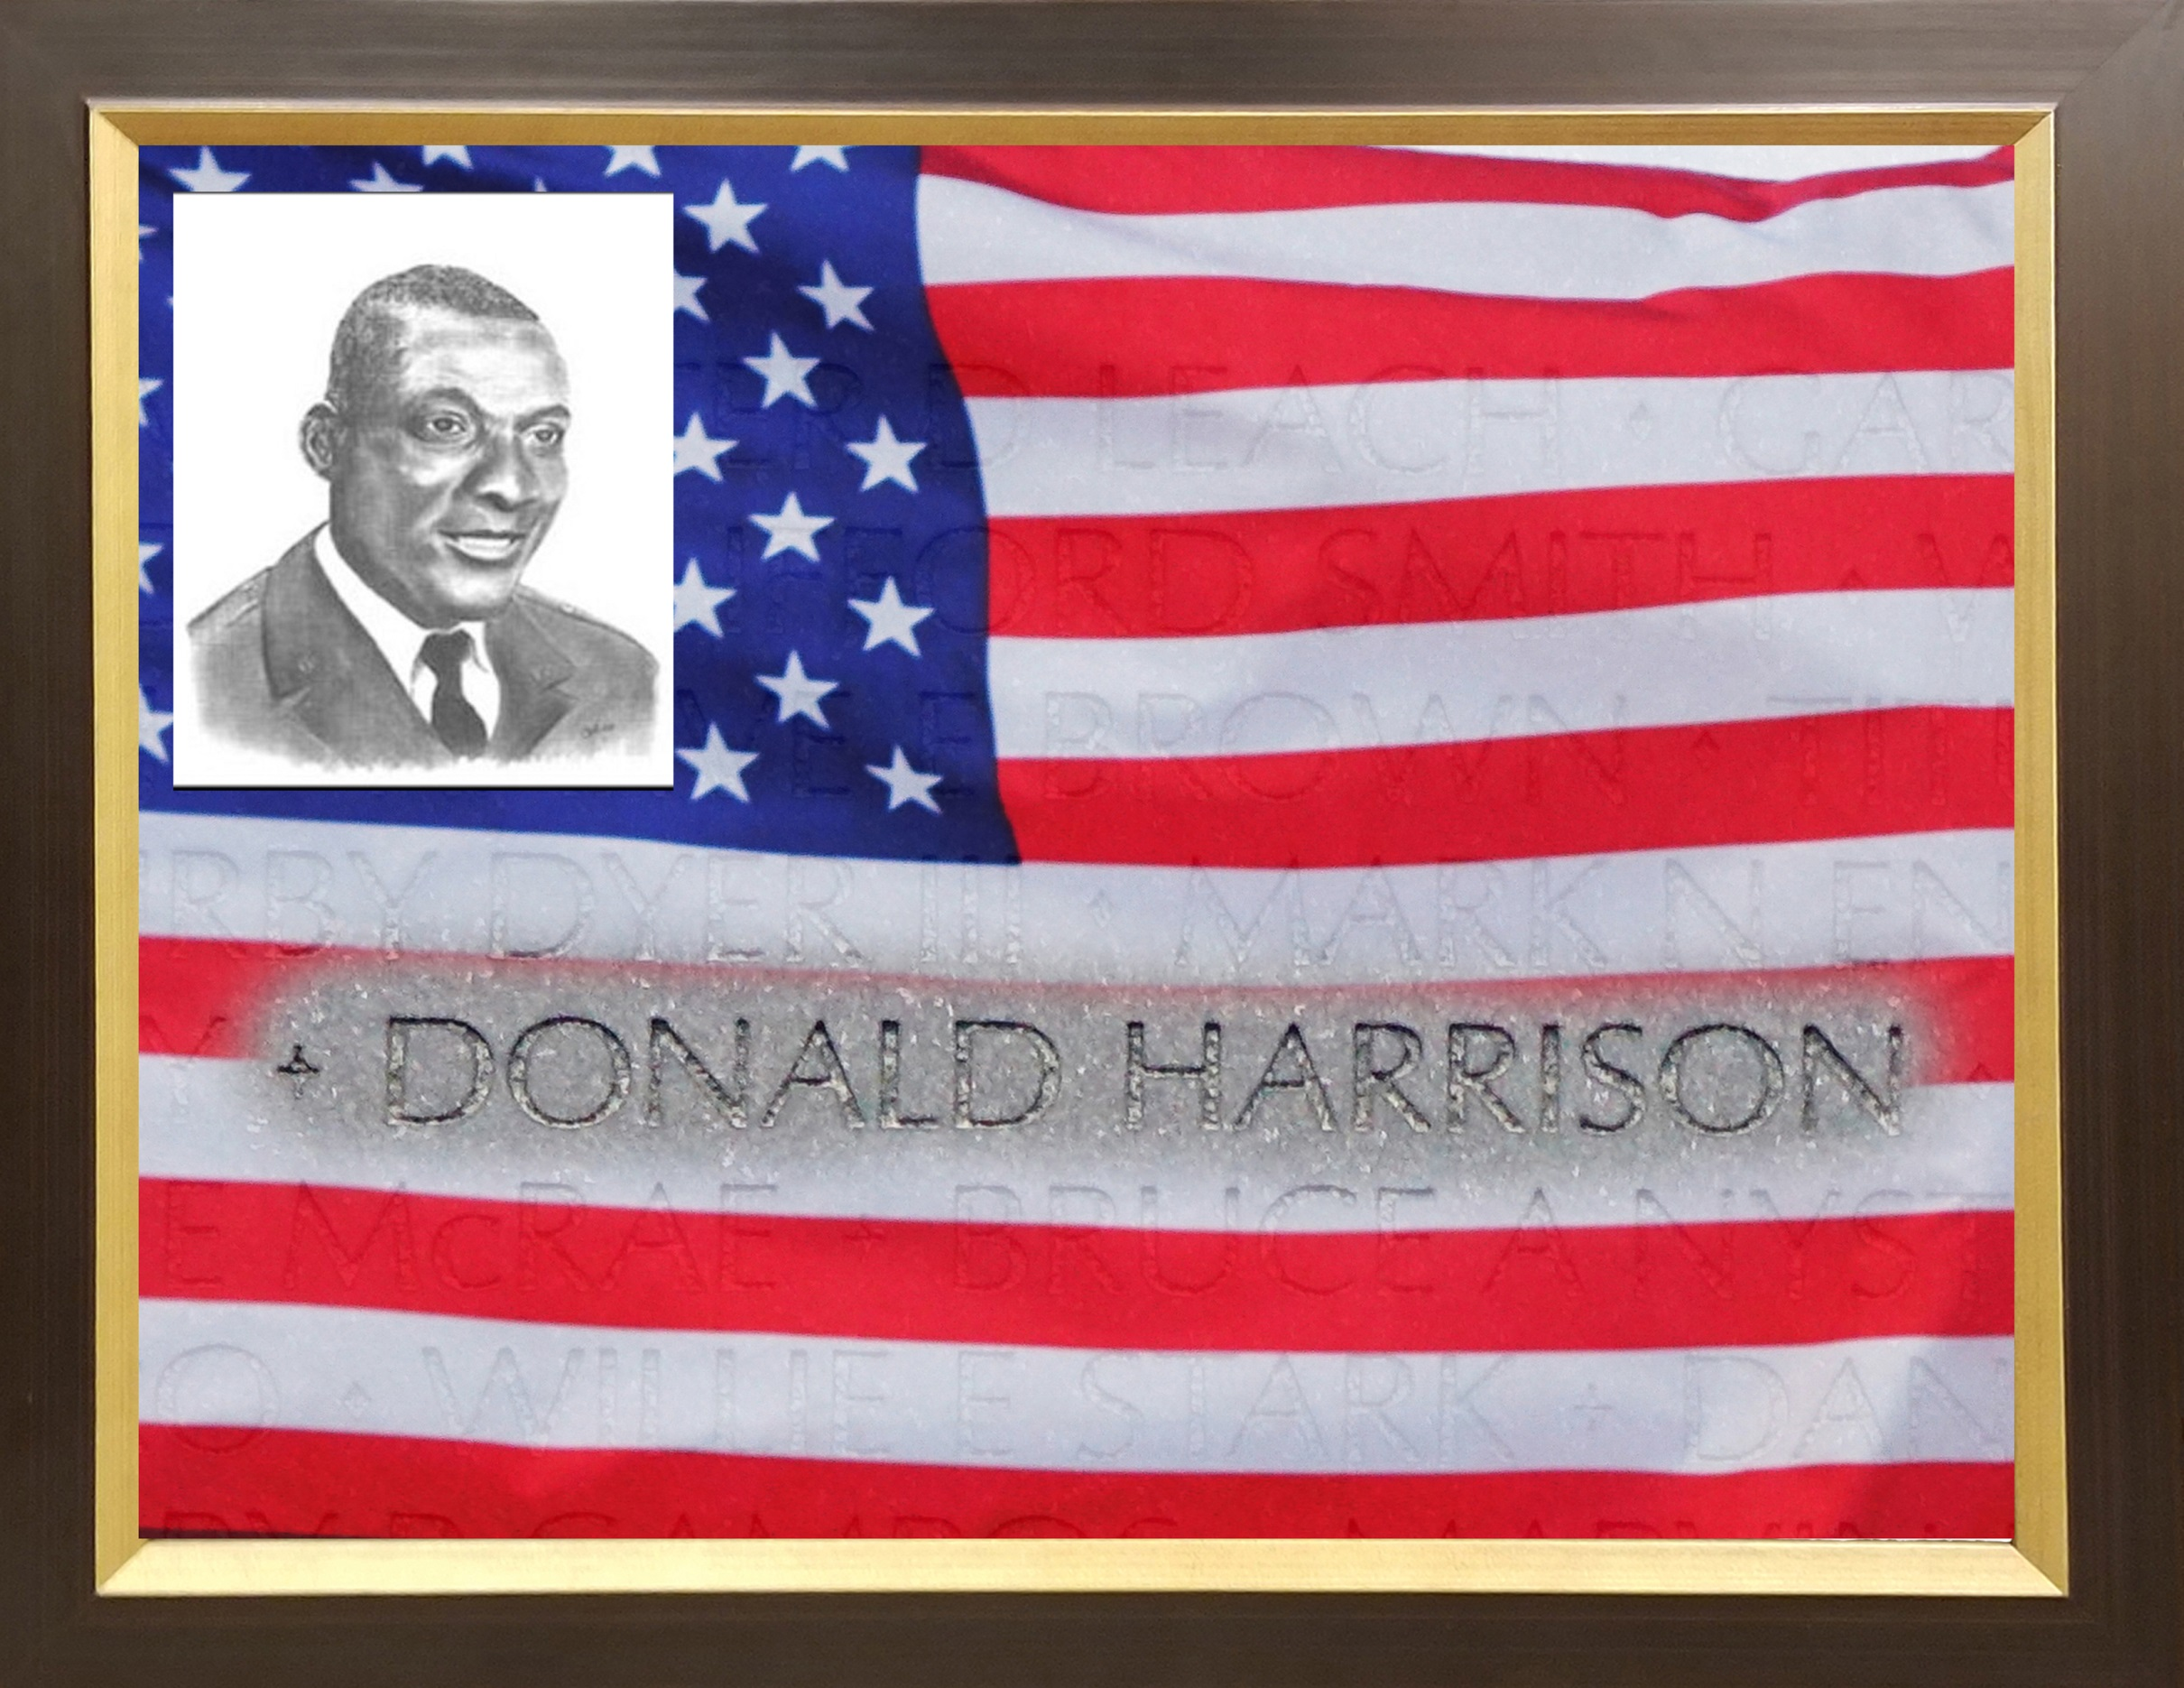

Slide 30
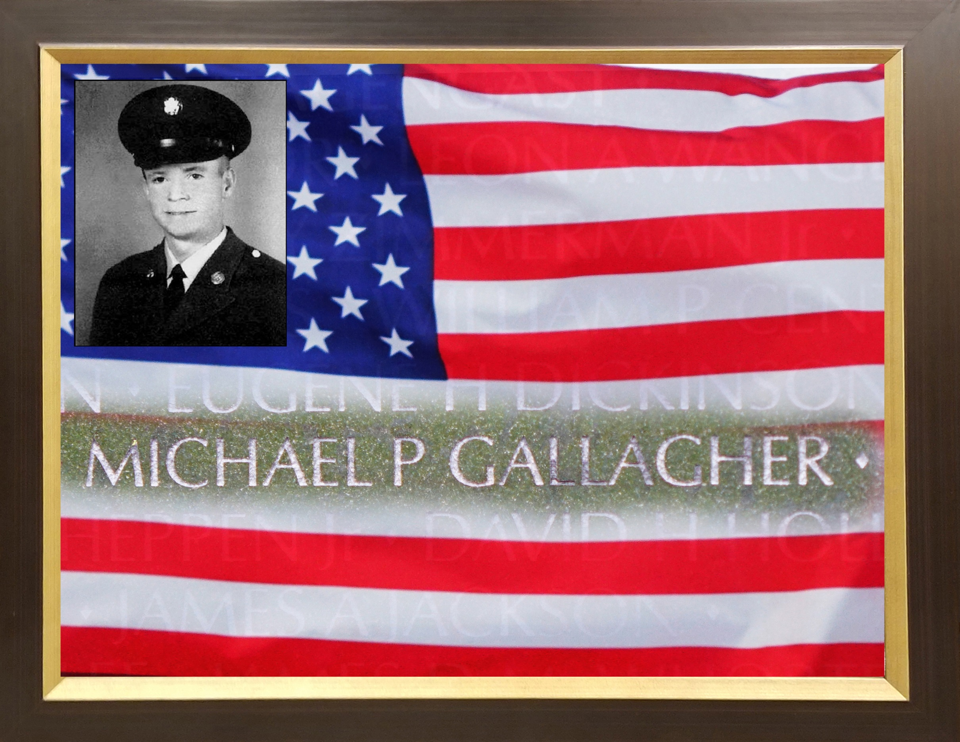

Slide 31
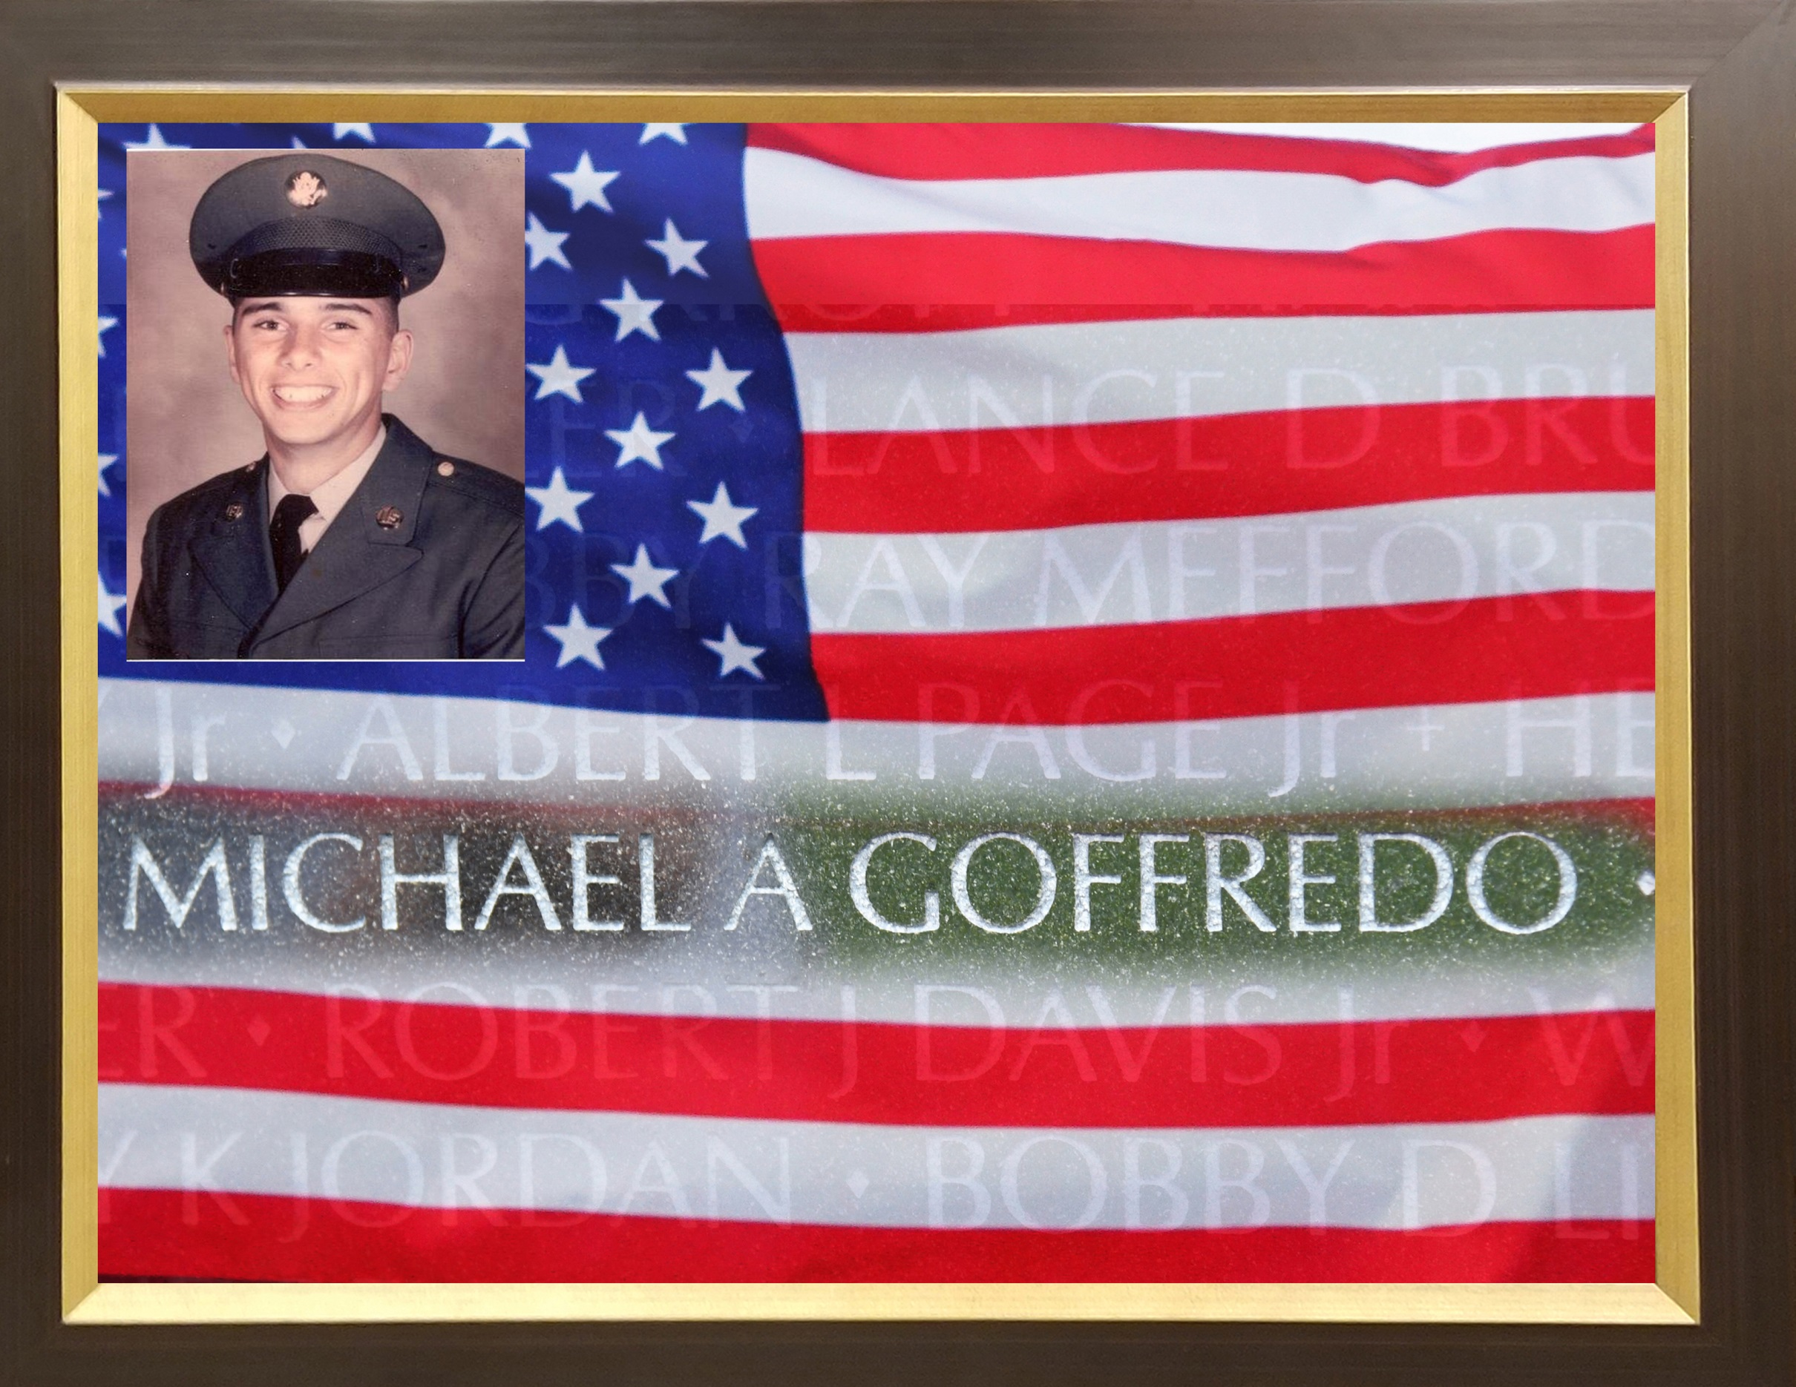

Slide 32
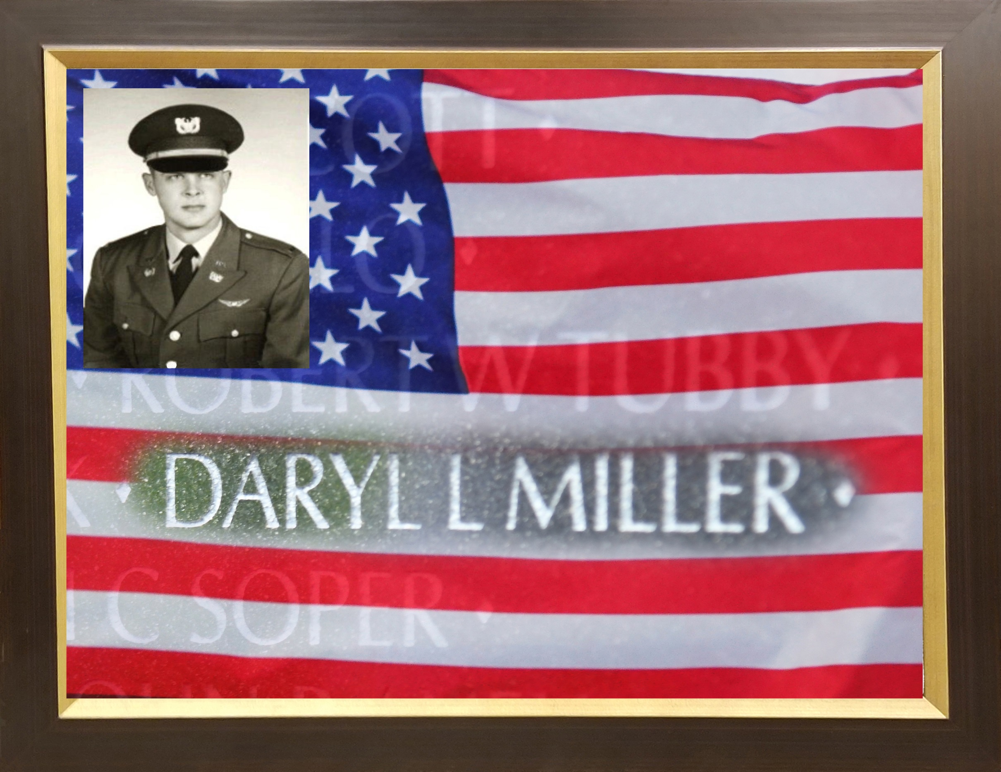

Slide 33
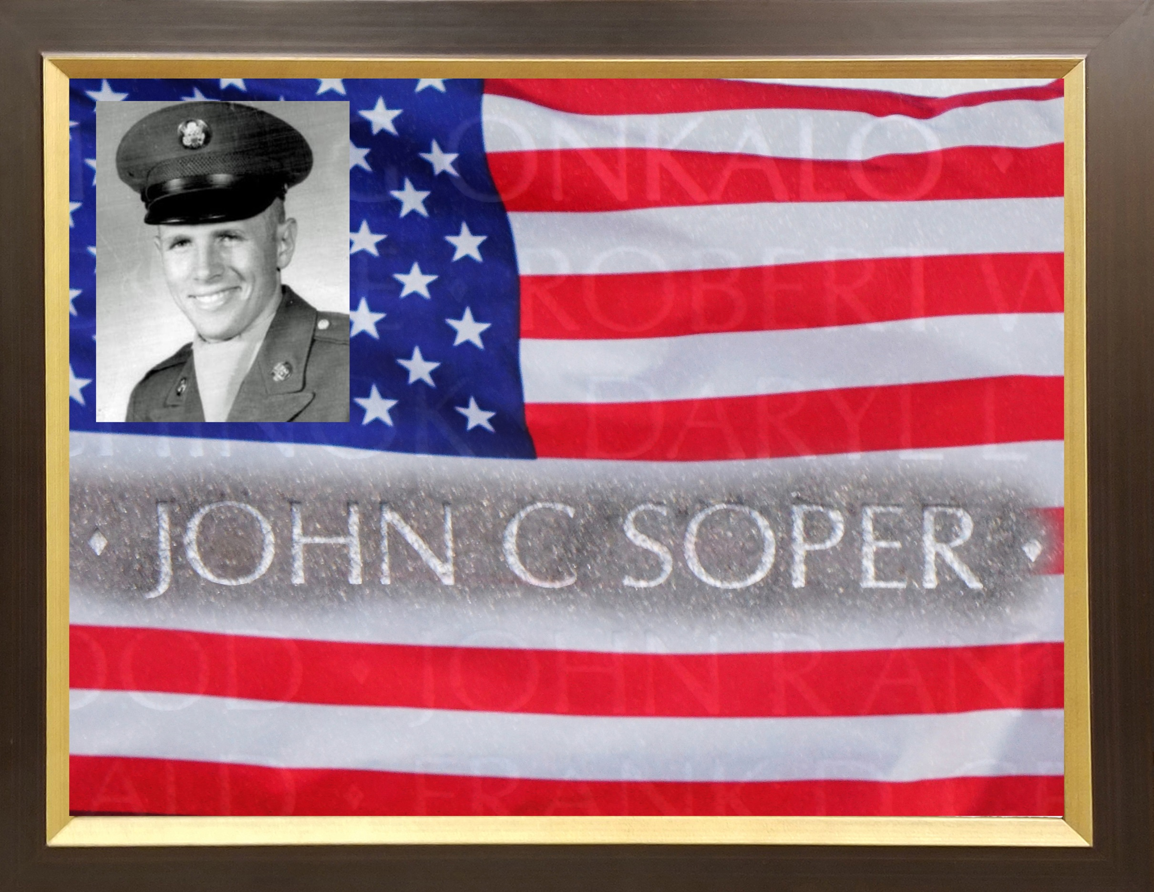

Slide 34
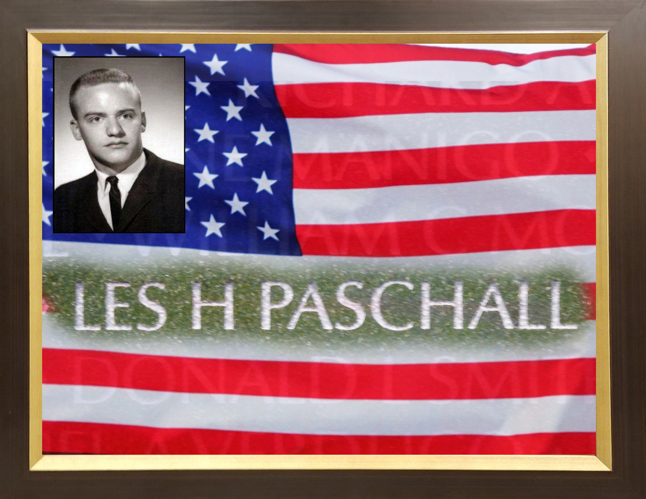

Slide 35
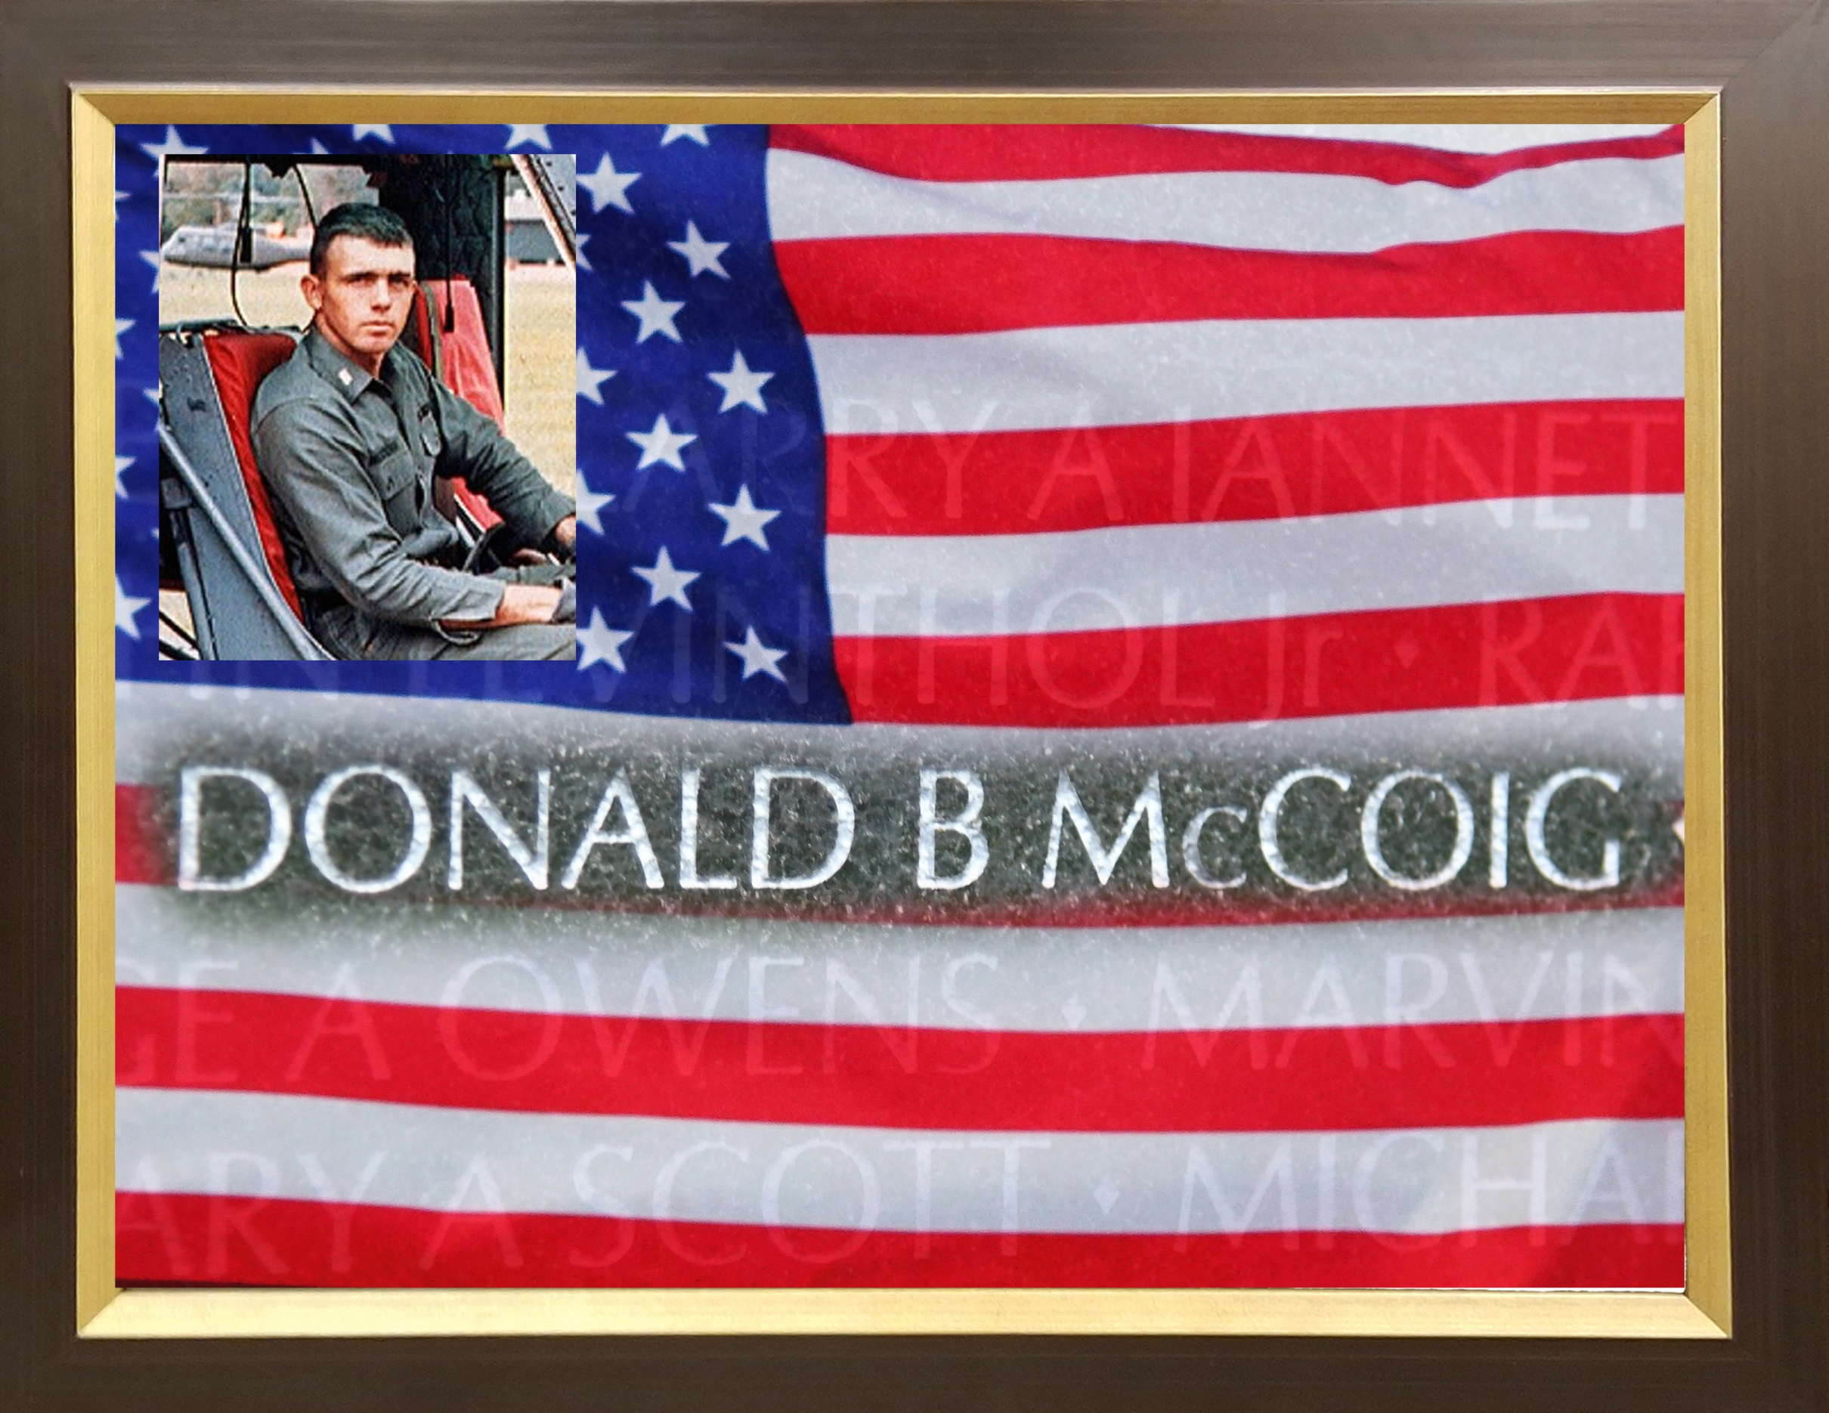

Slide 36
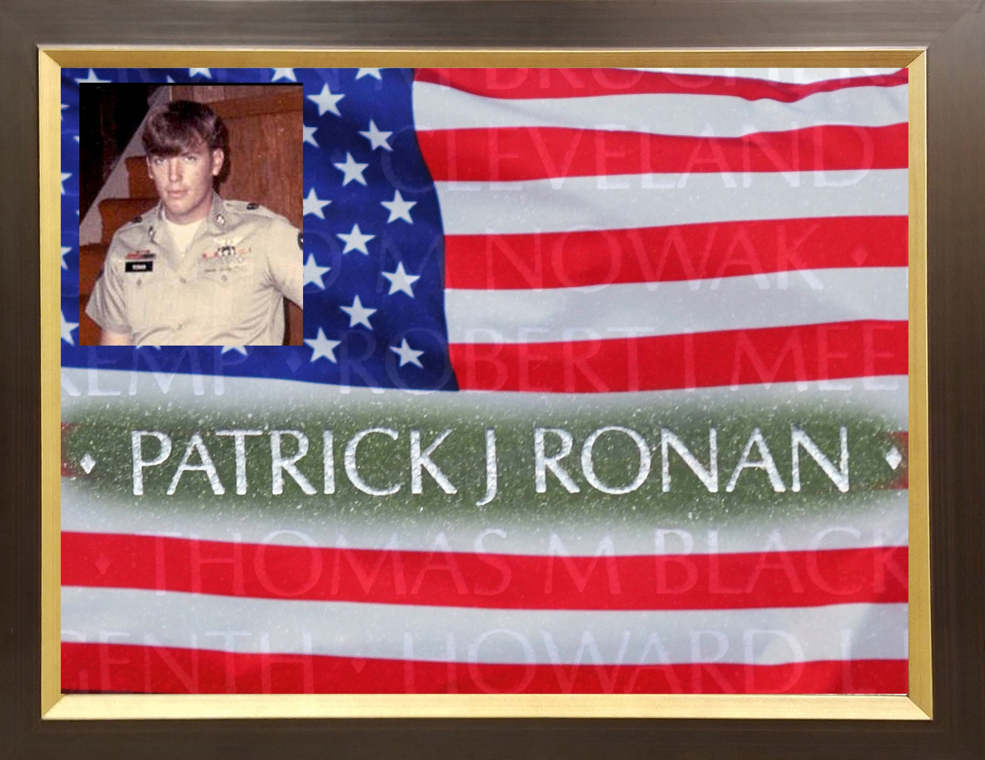

Slide 37
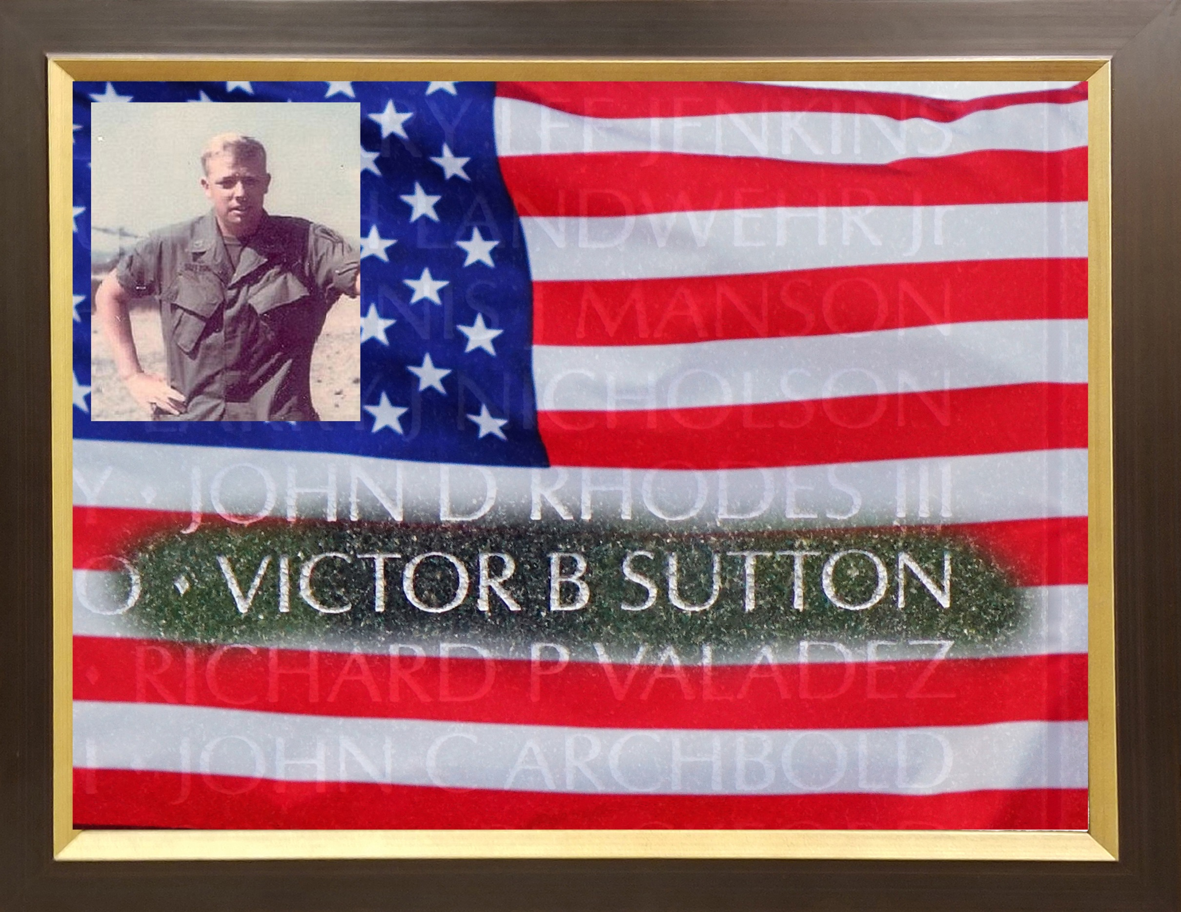

Slide 38
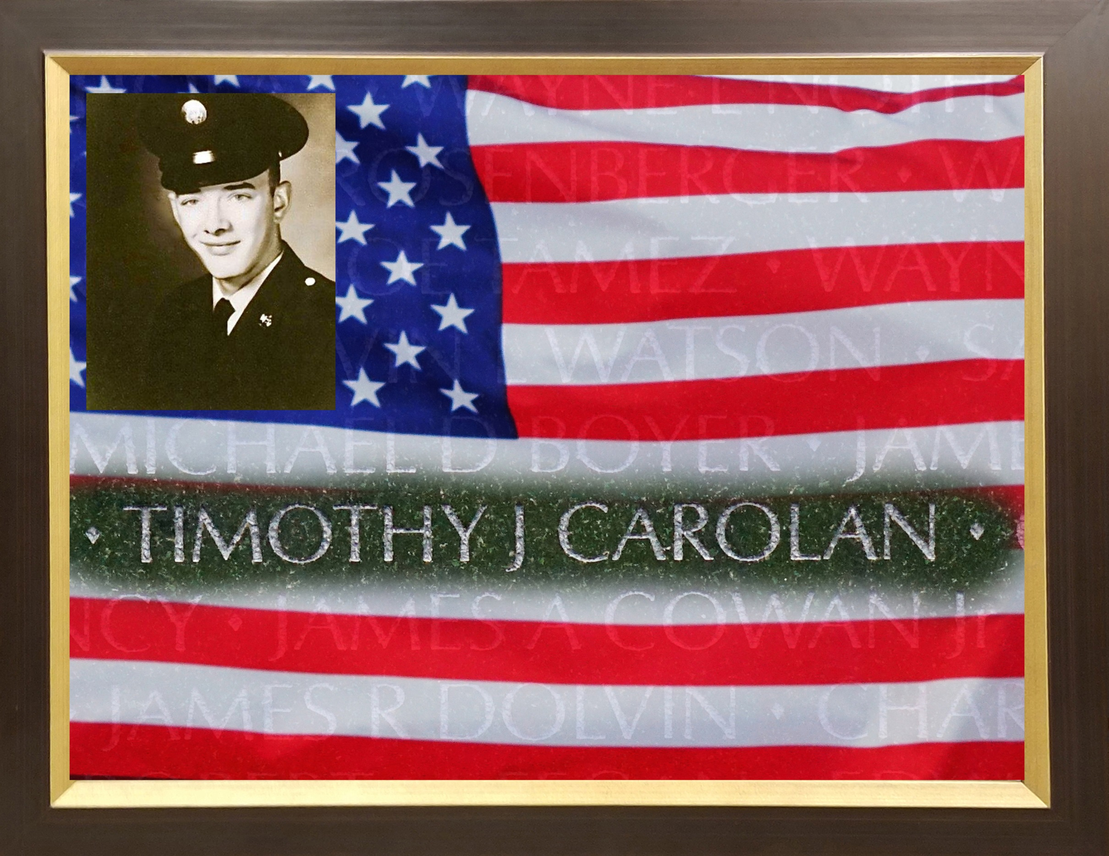

Slide 39
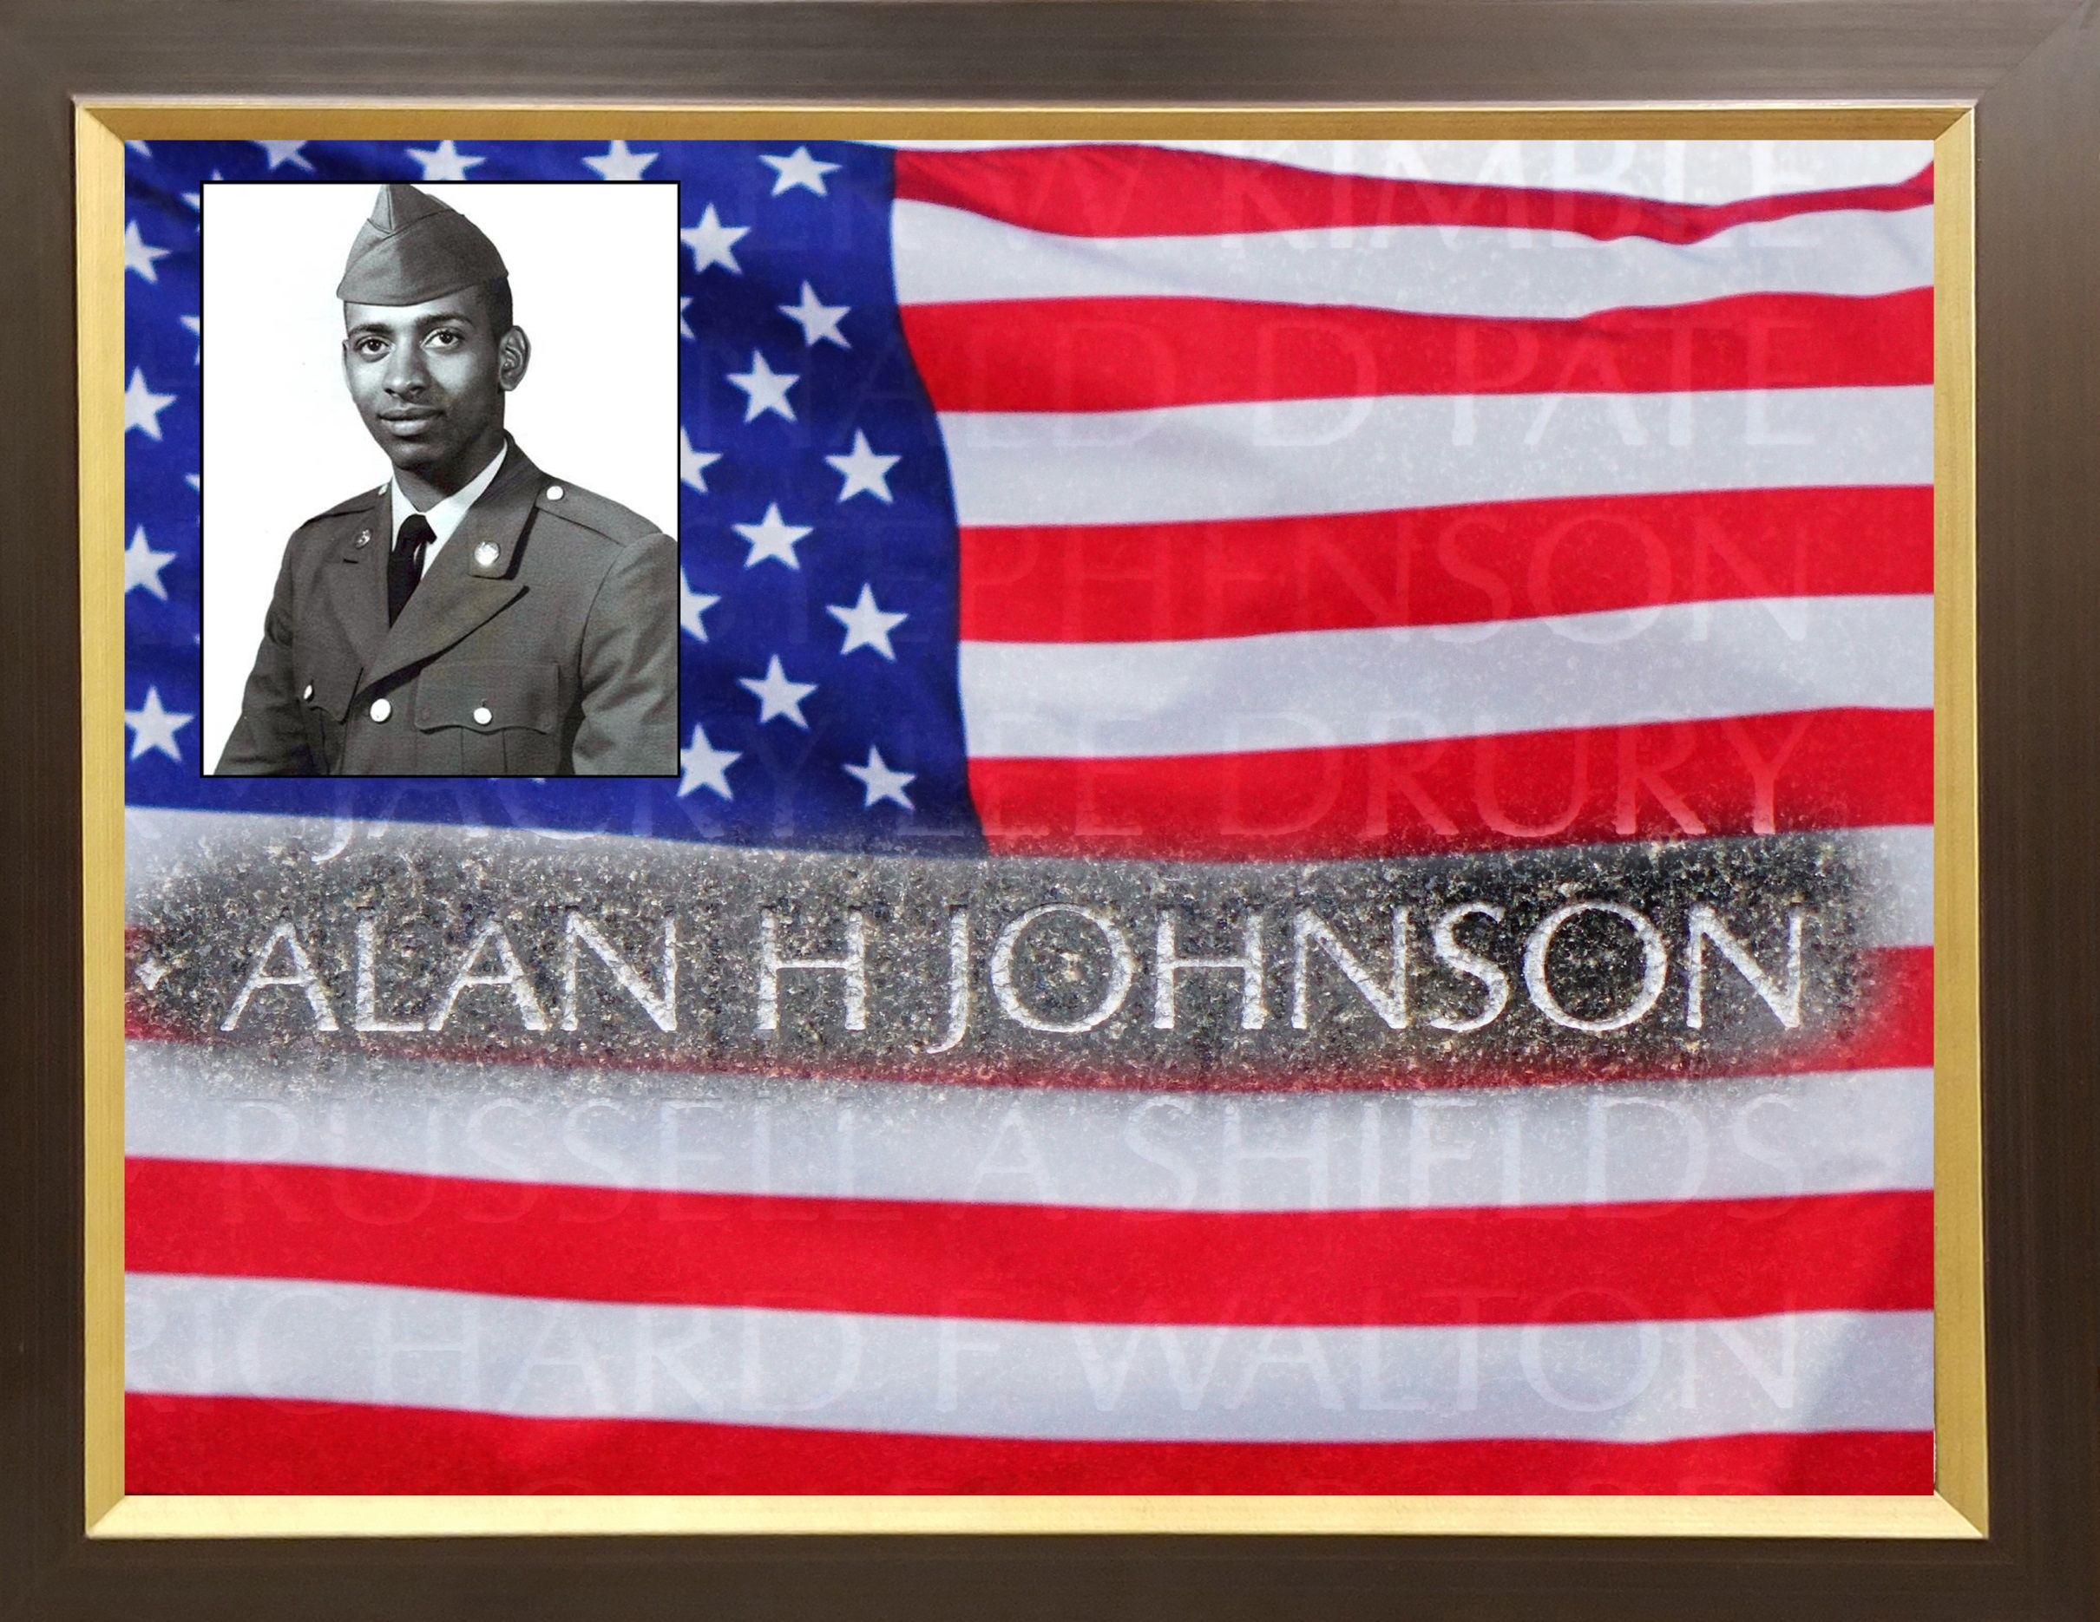

Slide 40


Slide 41
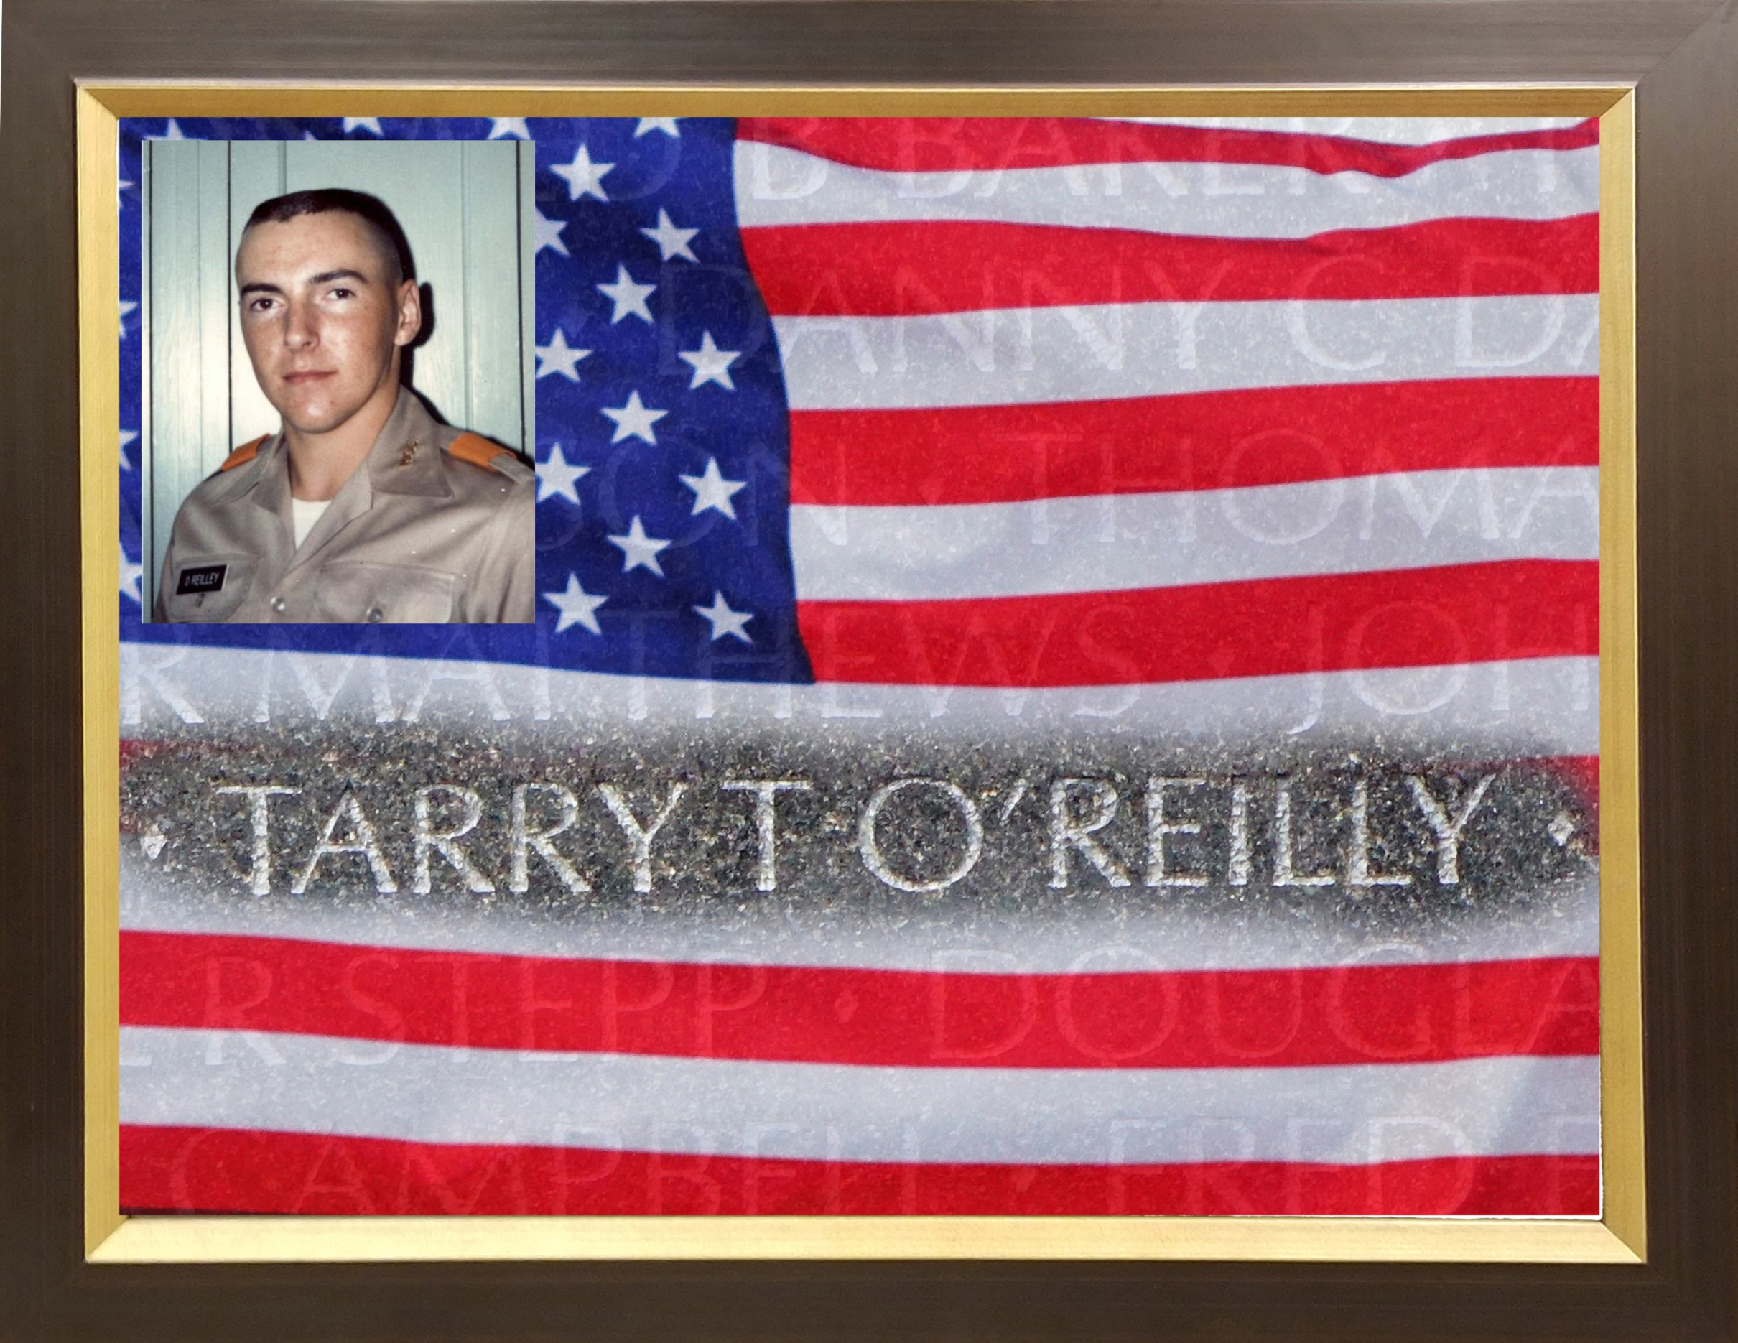

Slide 42
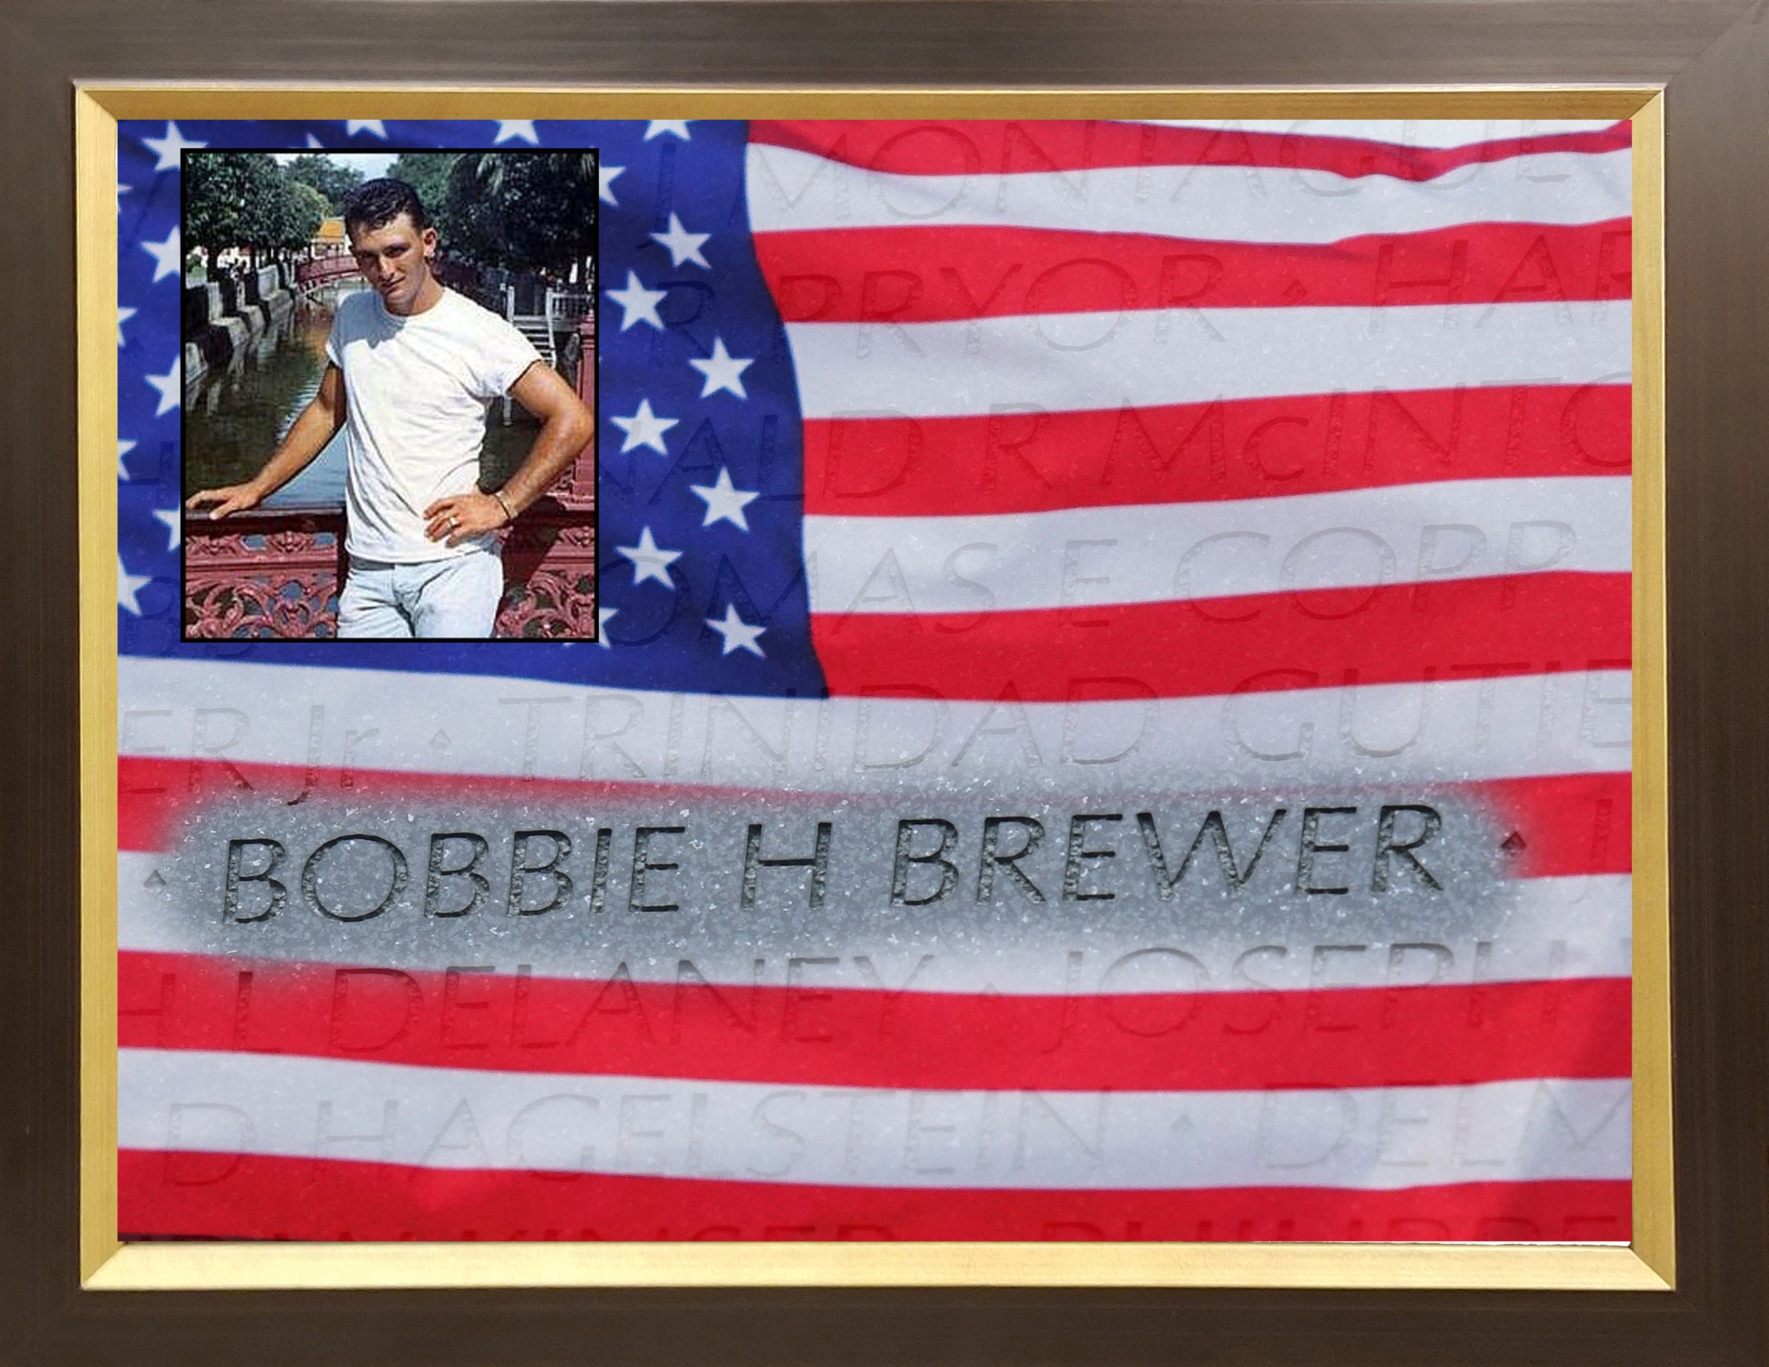

Slide 43
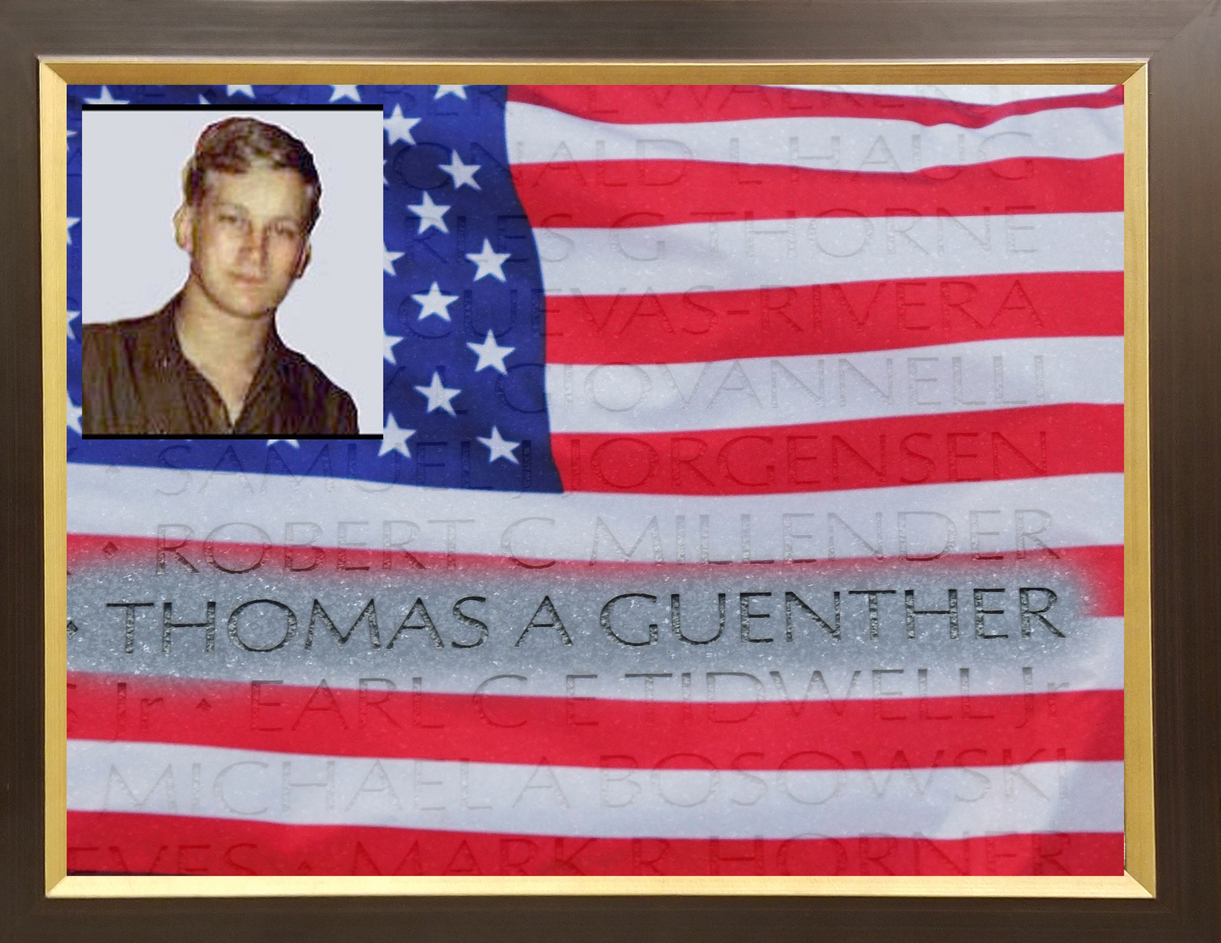

Slide 44
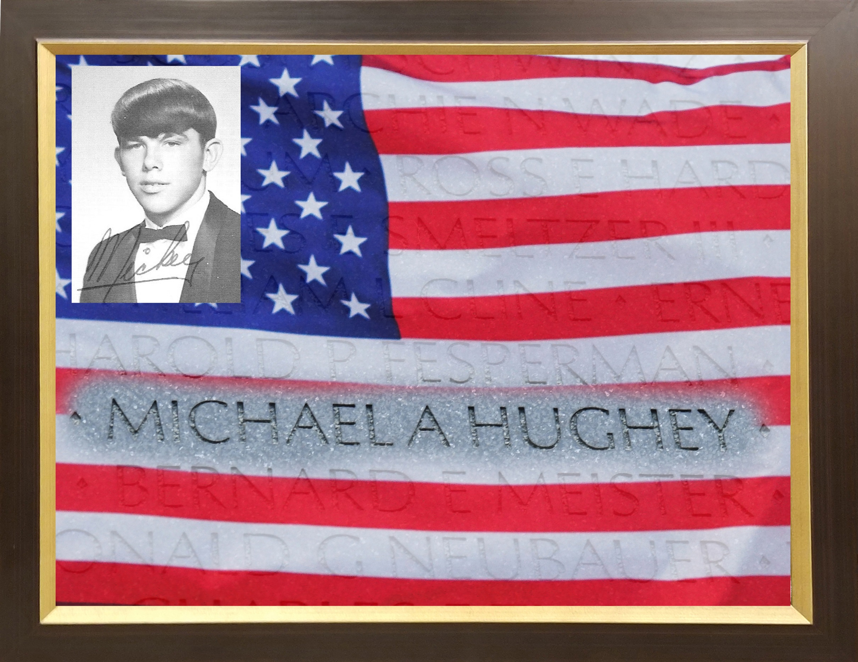

Slide 45
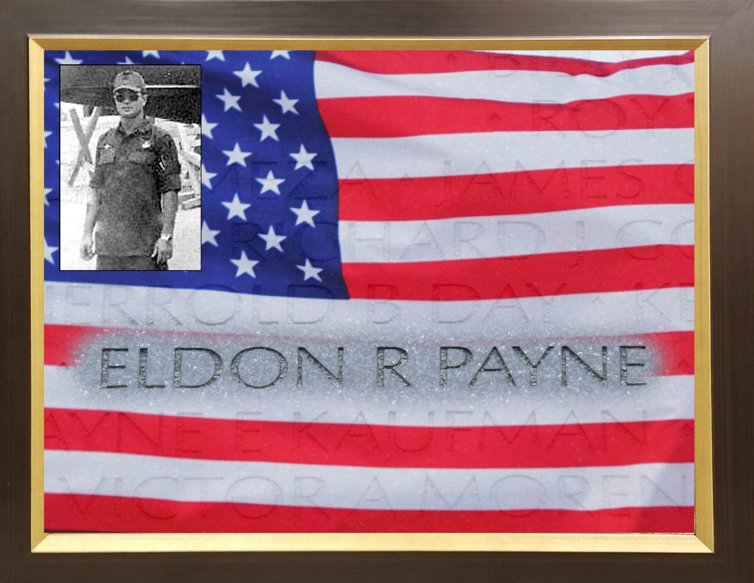

Slide 46


Slide 47
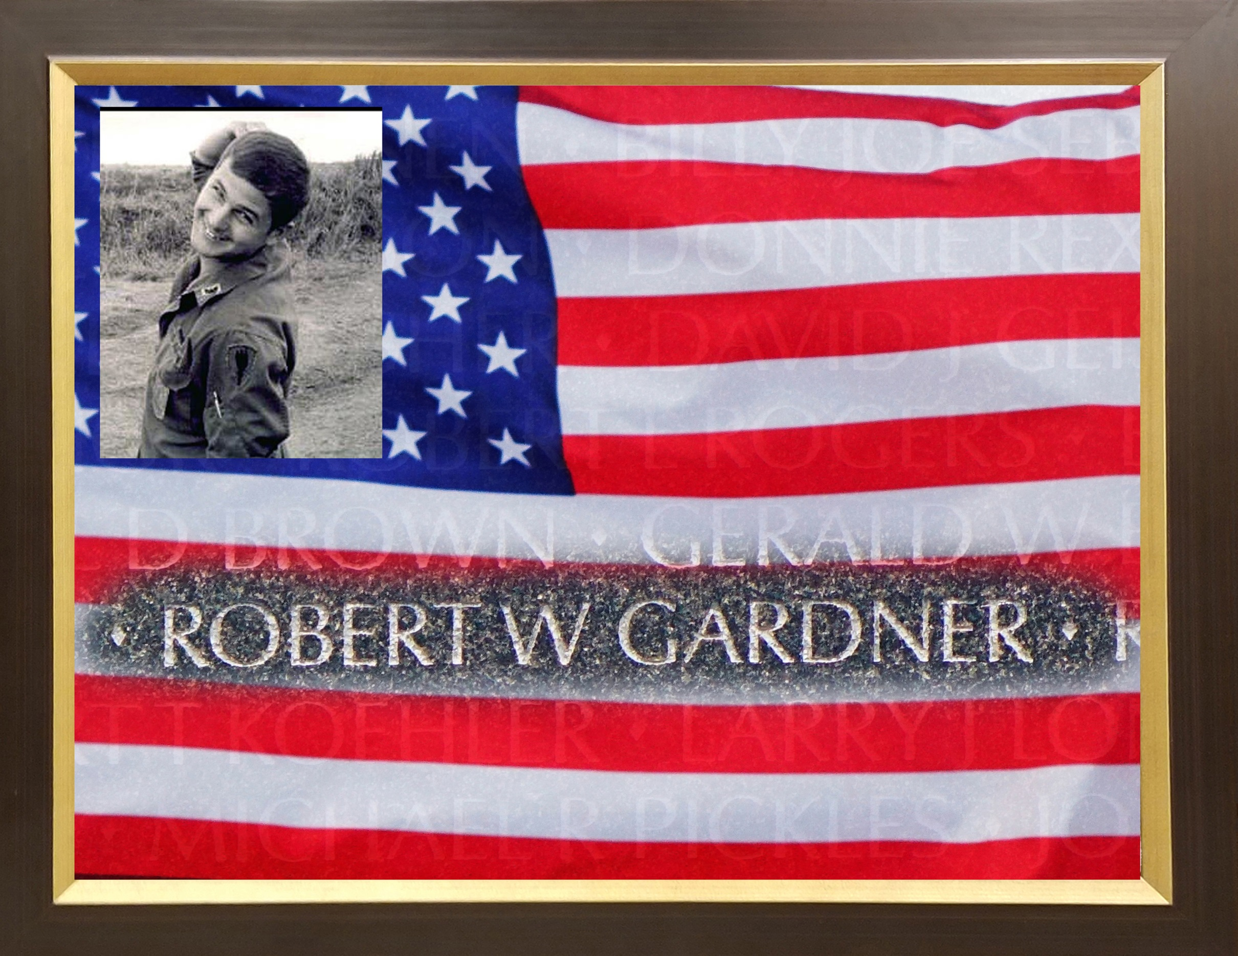

Slide 48
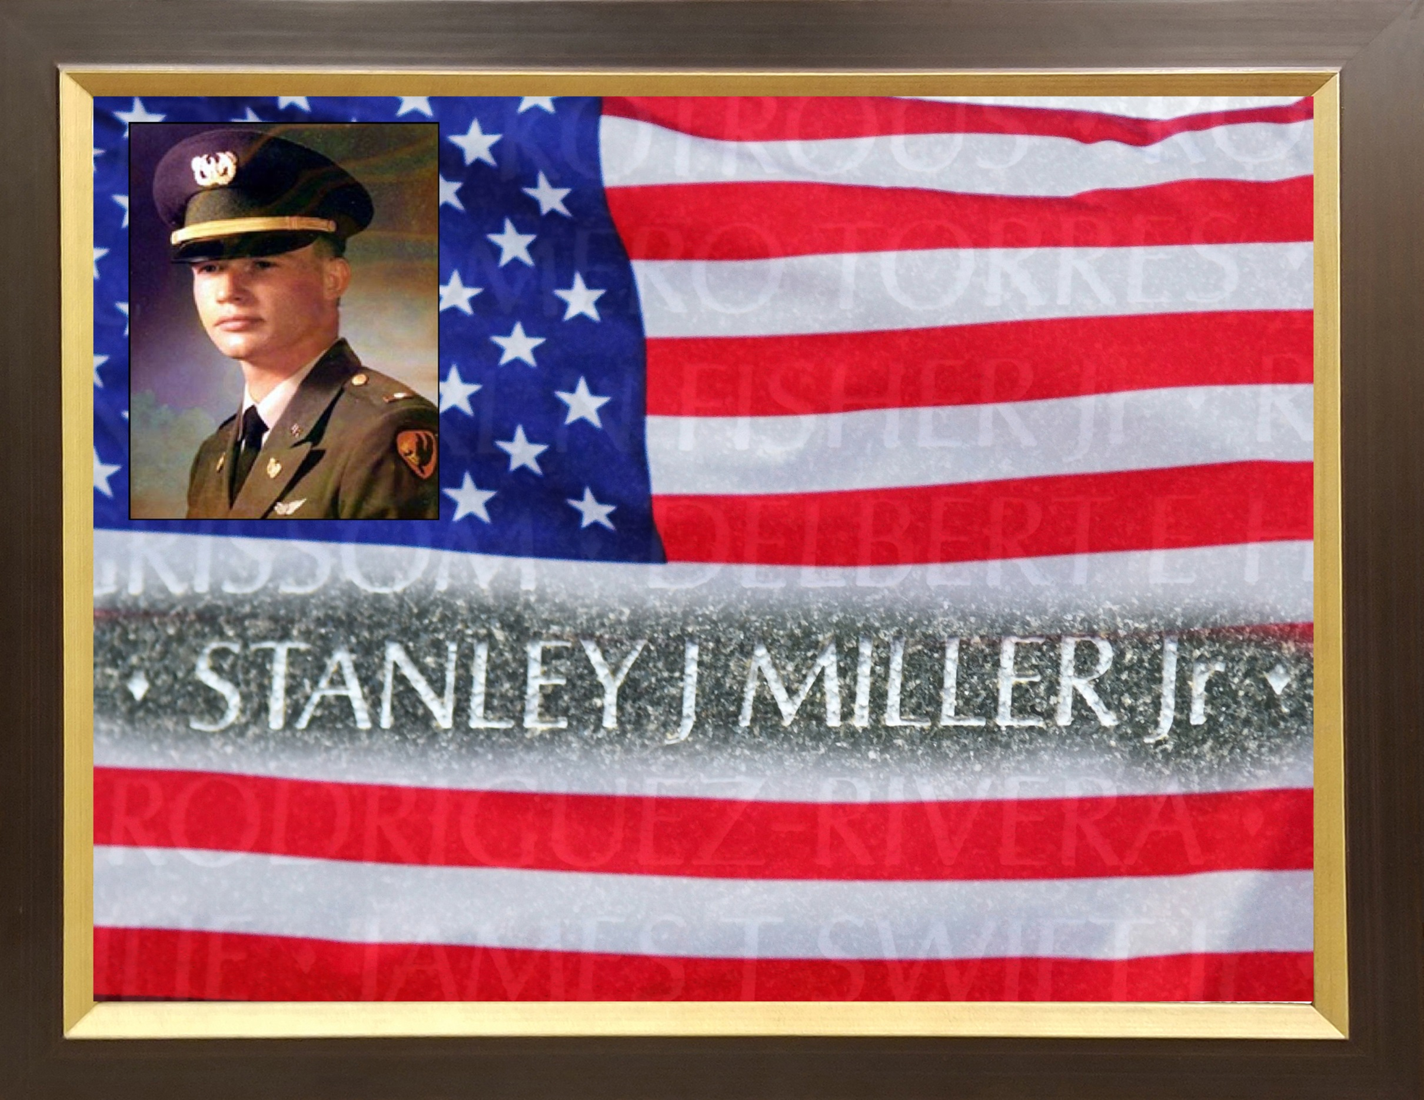

Slide 49
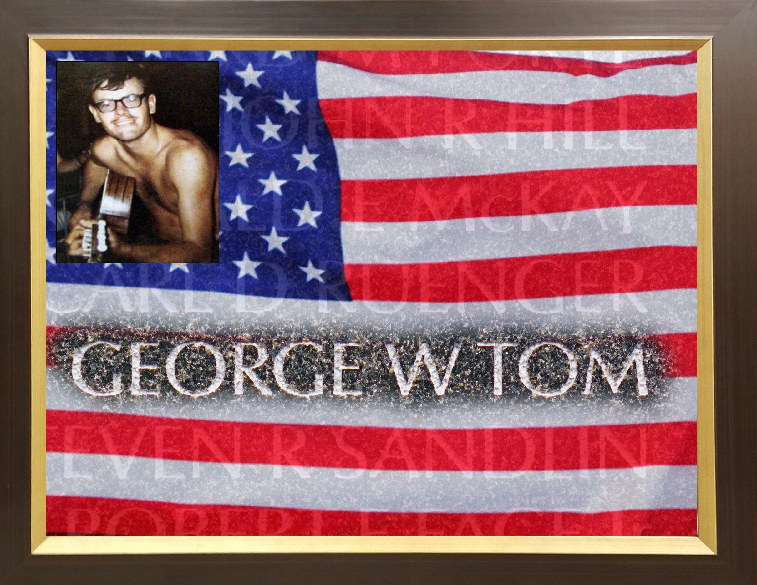

Slide 50
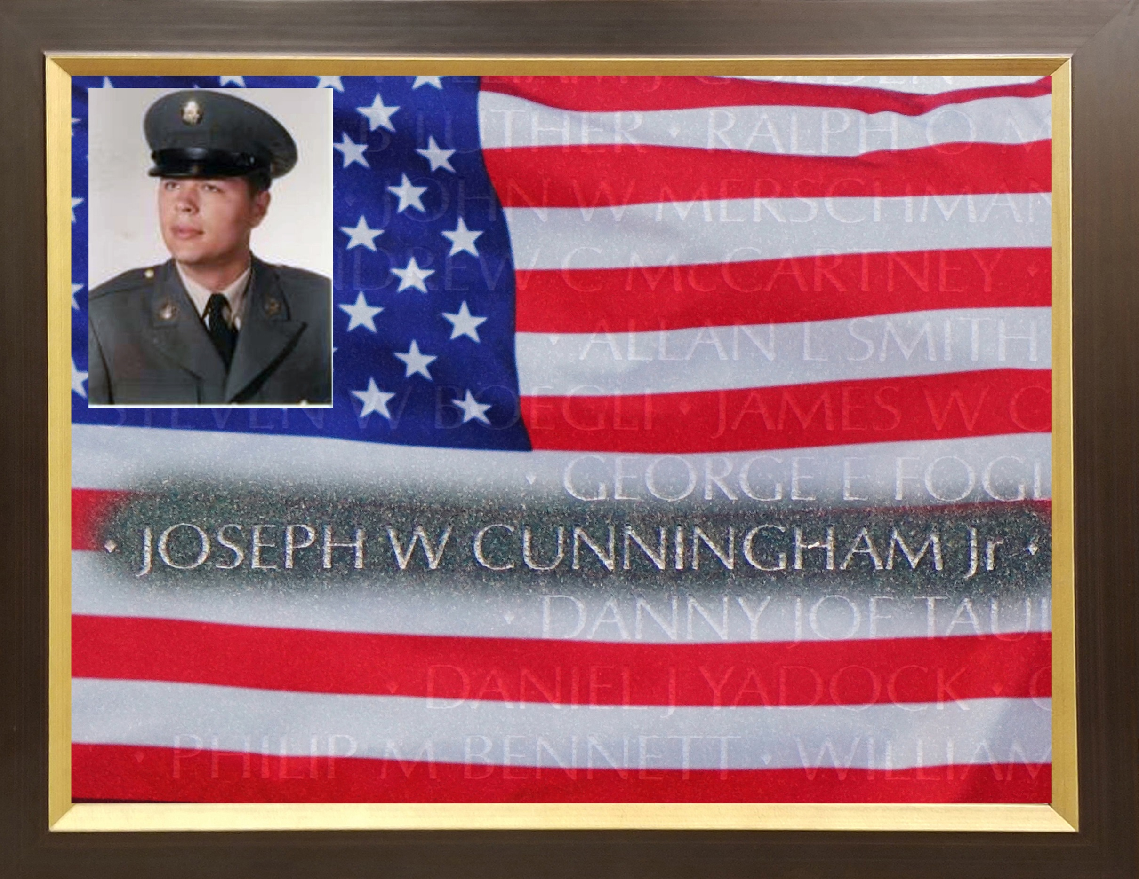

Slide 51
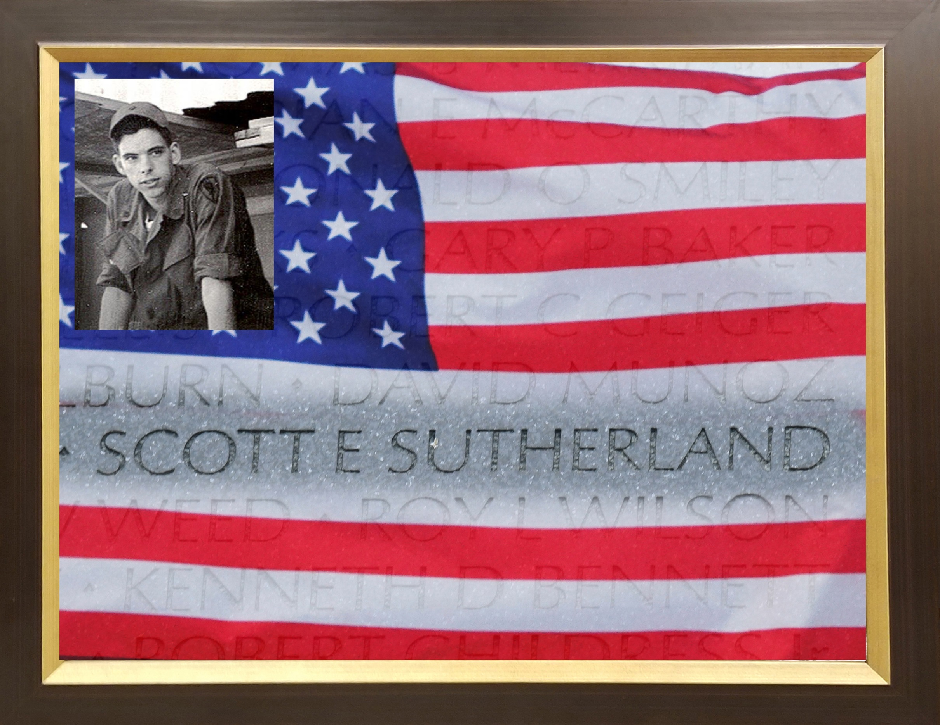

Slide 52
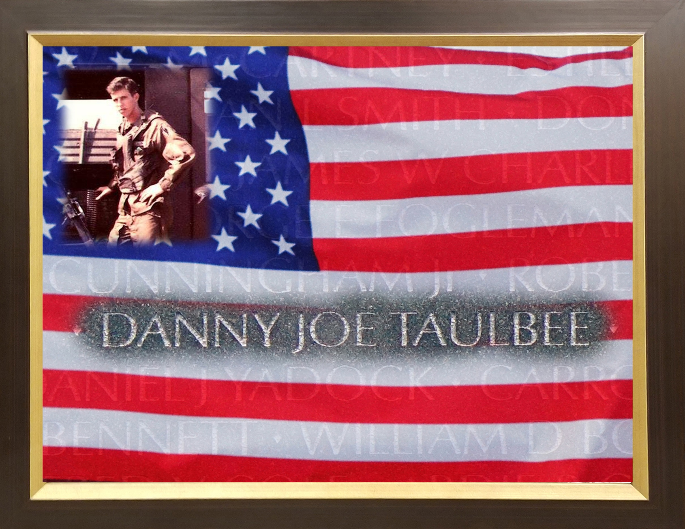

Slide 53
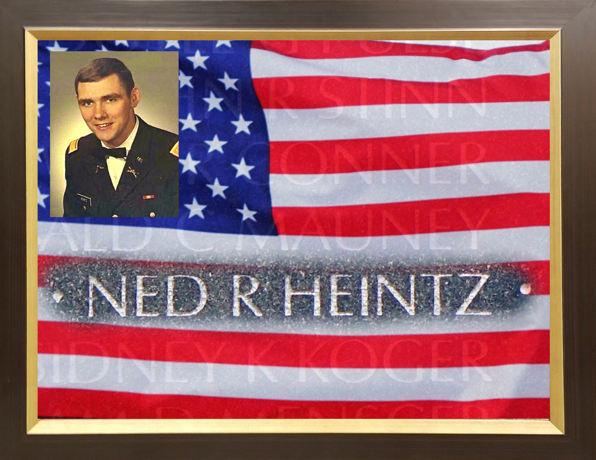

Slide 54
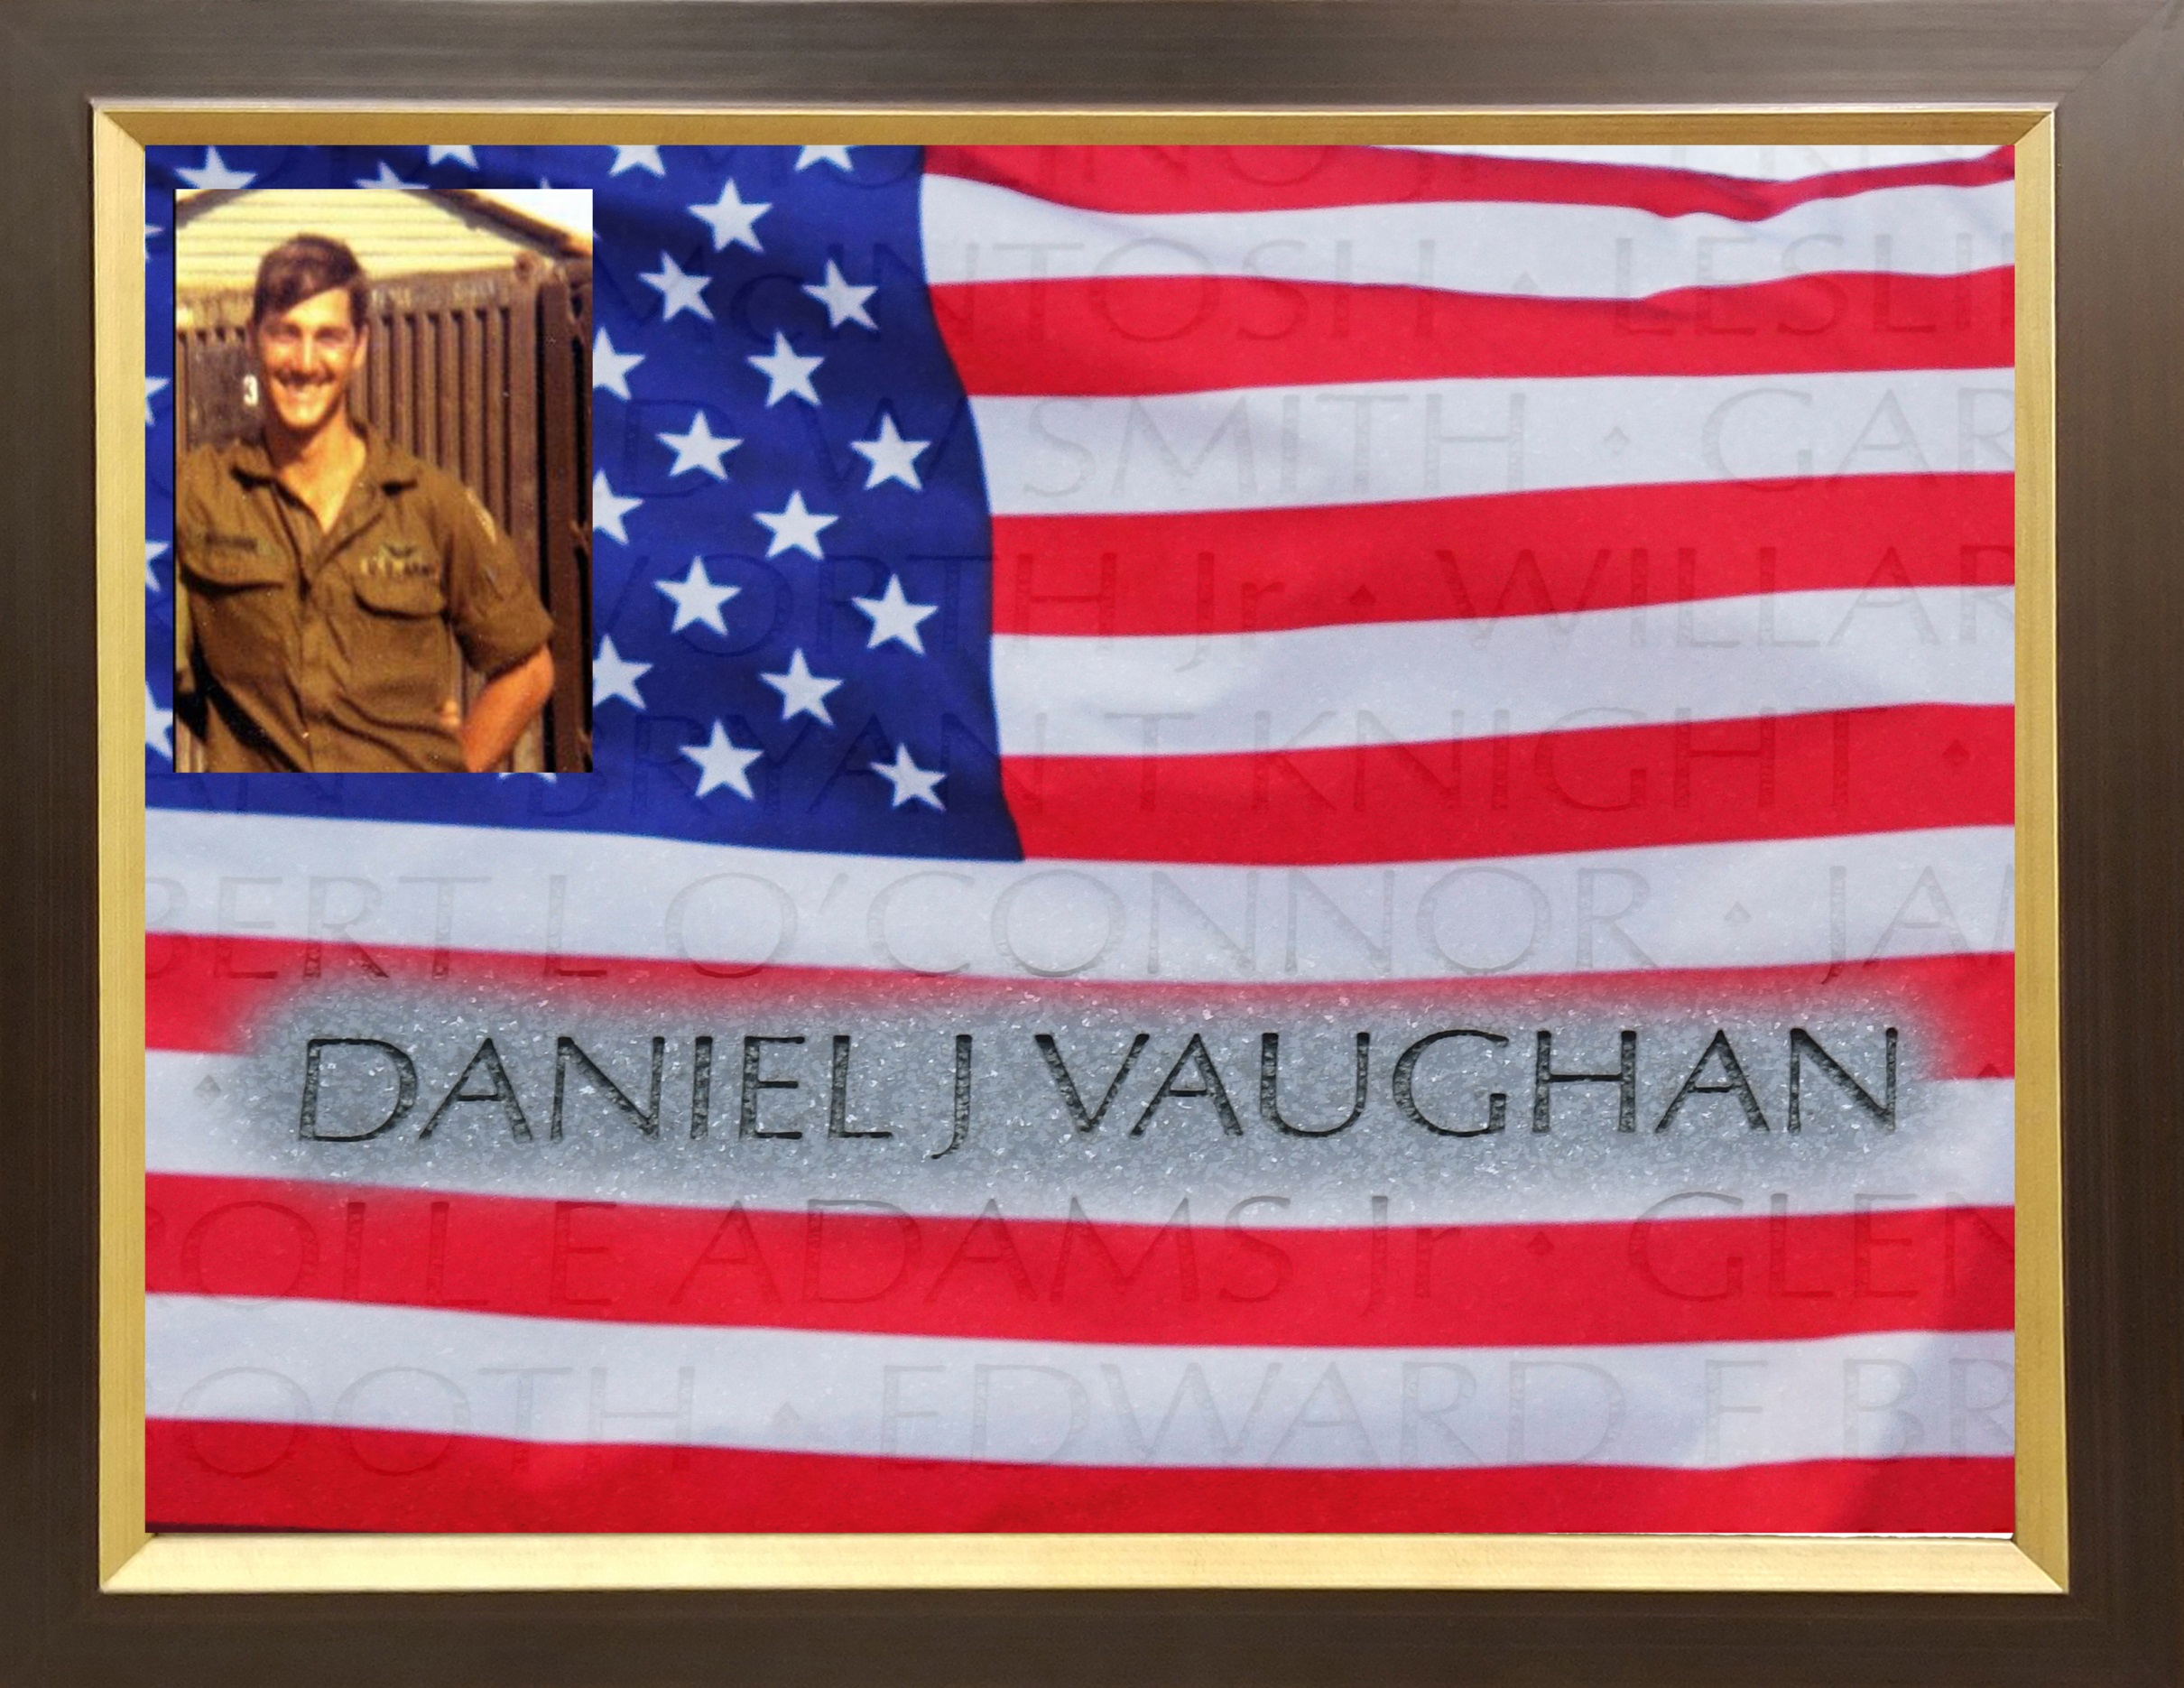

Slide 55


Slide 56
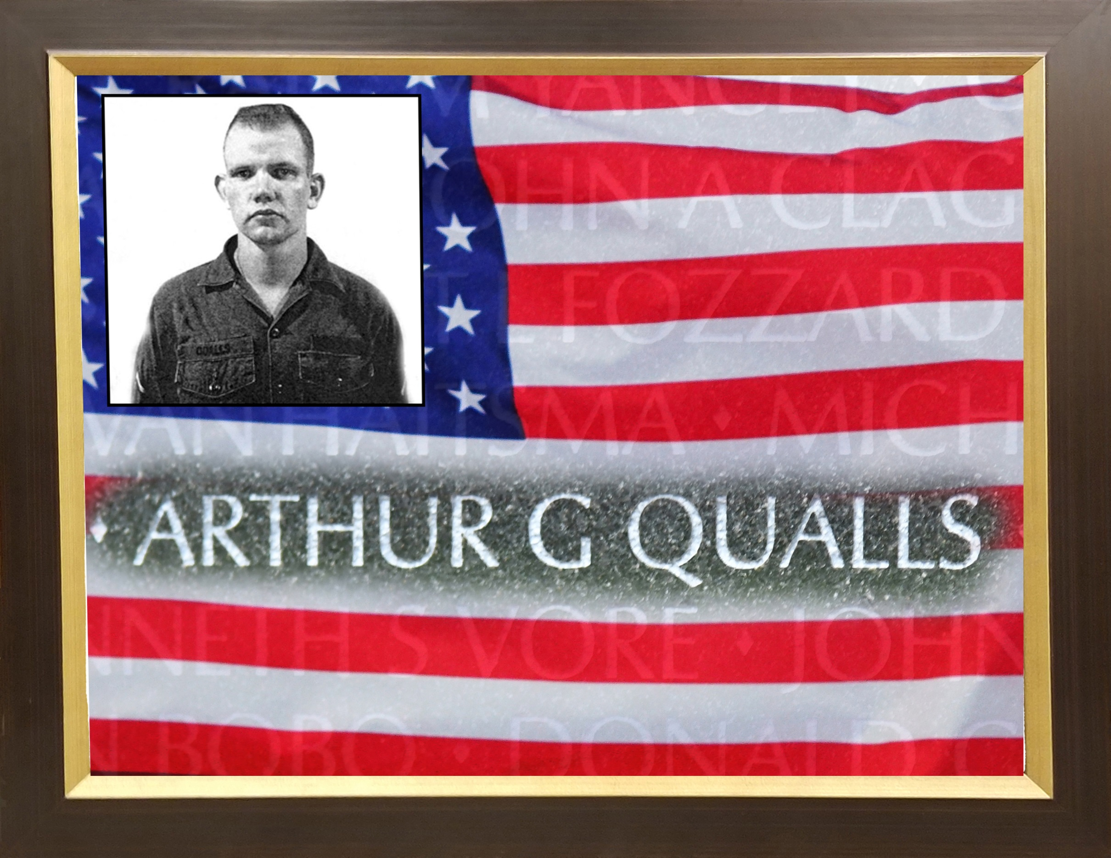

Slide 57
War drew us from our homeland In the sunlit springtime of our youth. Those who did not come back alive remain in perpetual springtime -- forever young -- And a part of them is with us always.
-- Author Unknown--

